Slide 1
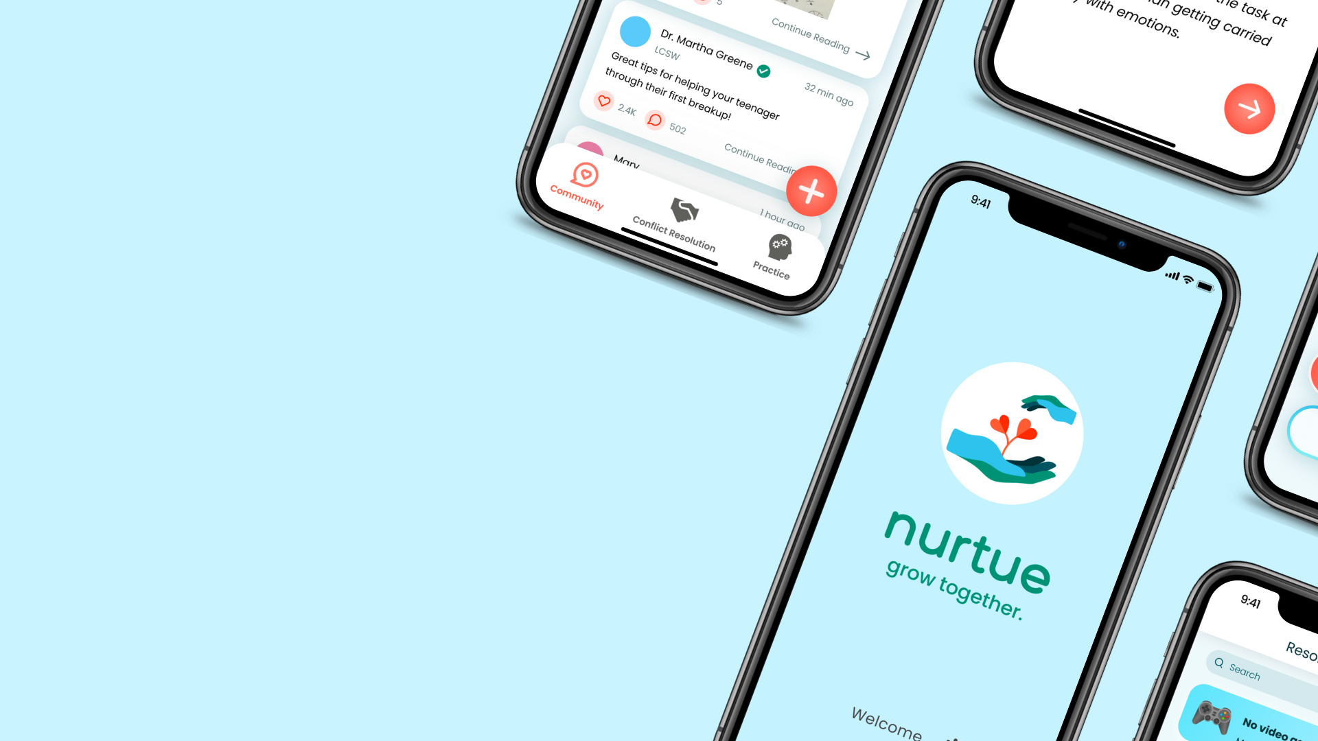


Team 2
Caring From Within - 2:30PM

Slide 2
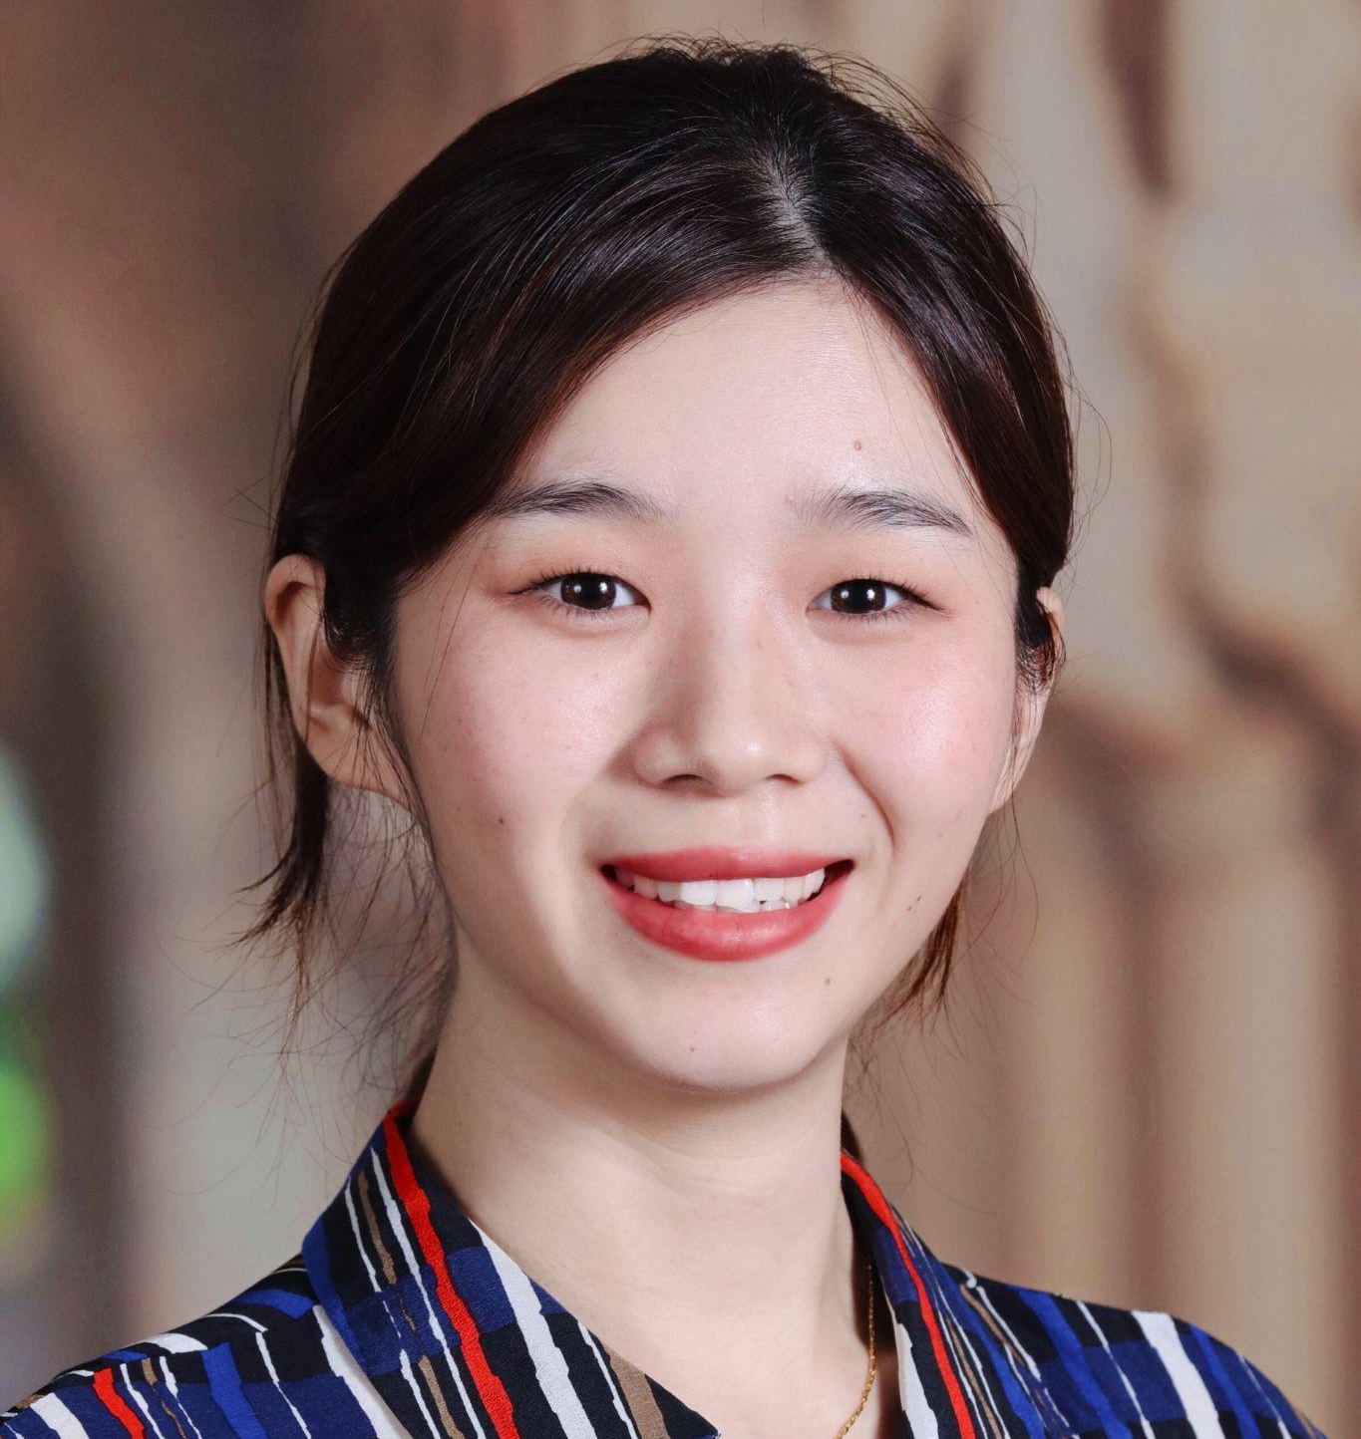
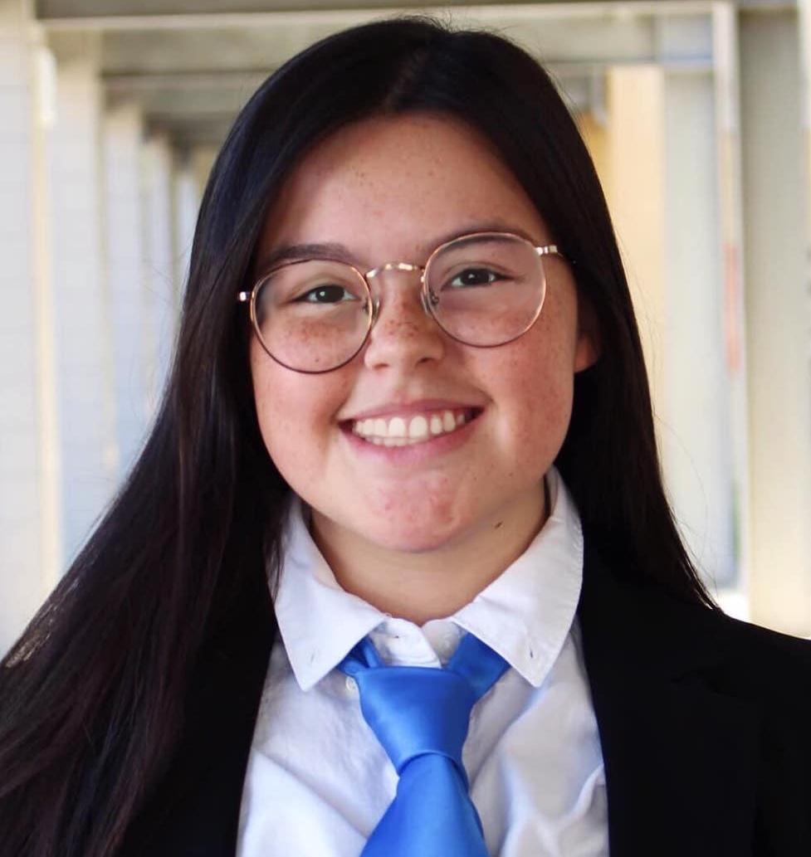

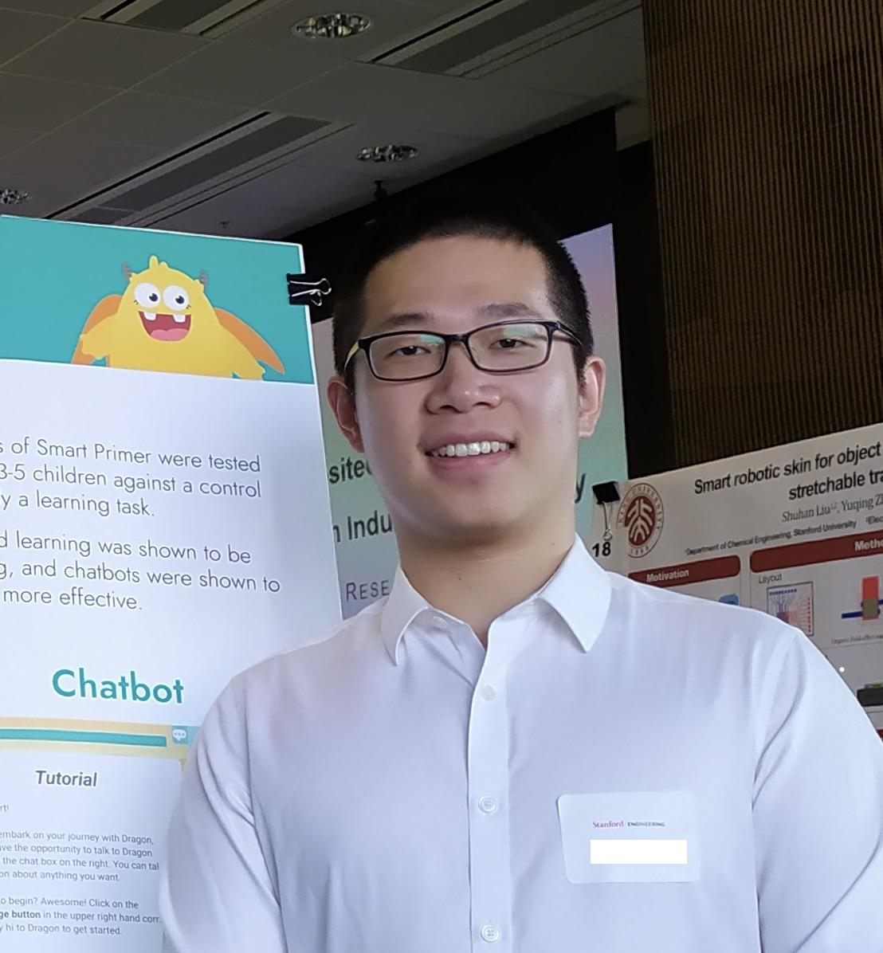
Our Team
Meng G.
UX Researcher
M.S. Symbolic Systems, C/O ‘23
Catherine H.
Product Manager
B.S. Computer Science (HCI),
C/O ‘23
Dyllen N.
Product Designer
B.S. Human-Centered Design and Engineering,
C/O ‘24
Rui Y.
Software Engineer
M.S. Computer Science (HCI), C/ O ‘23

Slide 3
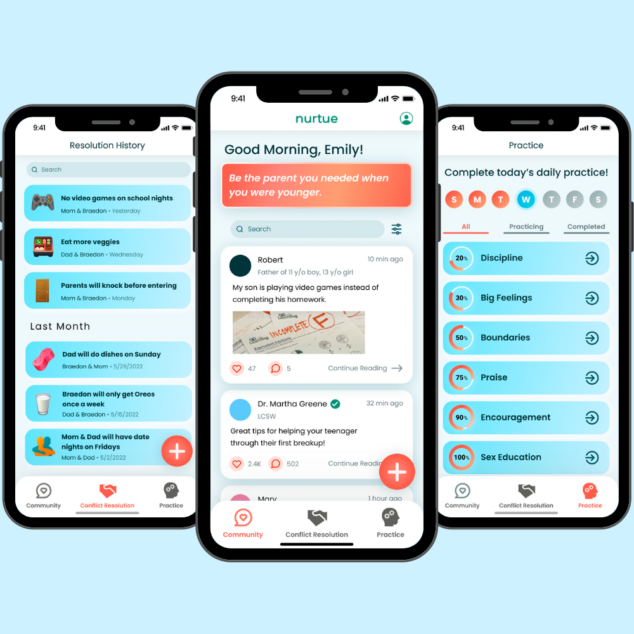
Value Proposition
The Problem
The Solution
Grow together.
Parents sometimes feel inadequate in their parenting efforts and would like validation and guidance. They also express concerns about handling conflicts with their children and want more productive conflict resolution.
Nurtue exists to improve relationships between parents and their children by promoting healthy communication habits and communal support. Nurtue connects parents with experts for recommendations, uses quizzes to help parents practice parenting skills and makes conflict resolution between parents and kids more meaningful.

Slide 4
Encoded Values
Value Conflicts
Inclusion of parents and experts of different backgrounds may reduce the efficiency when parents want to find specific advice for their demographics
Best ways to reach mental wellness may differ depends on parents’ culture backgrounds. What we do may not be truly inclusive.
Wellness
Support parents’ and children’s mental well-being by giving them useful tools and practices.
Features
Conflict Resolution
Communication Practice
1
2
Self-improvement
Show parents better ways for communicating and benefit them in the long run.
Feature
Communication Practice
Efficiency
Inclusion
4
3
Help parents record questions and agreements to facilitate future problem solving and conflict resolution.
Features
Conflict Resolution
Community Q&A
Welcome parents and parenting experts of different backgrounds to discuss their experience.
Feature
Community Q&A

Slide 5
Additional
Needfinding
Tasks

Slide 6
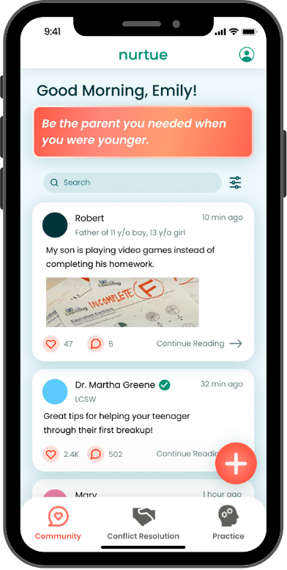
Task #1
Simple
Share your parenting struggles to get advice from fellow parents or/and experts in the field.
No change from the low-fi prototype assignment.

Slide 7
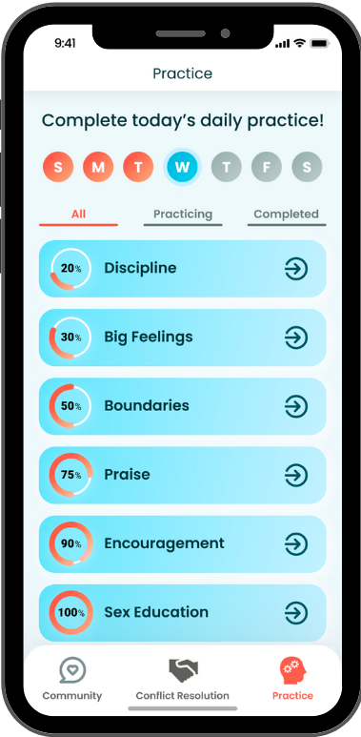
Task #2
Moderate
Practice more effective language to communicate with your child through interactive modules.
No change from the low-fi prototype assignment.

Slide 8
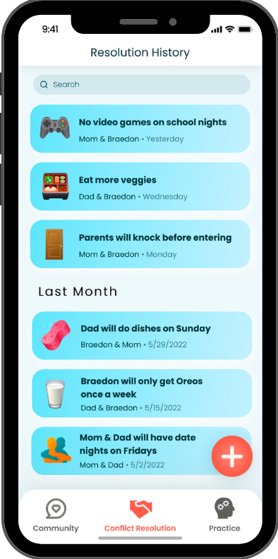
Task #3
Complex
Resolve a particular conflict with a child in a peaceful manner, and come to an agreement that the parent can reference.
No change from the low-fi prototype assignment.

Slide 9
Additional
Needfinding
Usability Goals &
Key Measurements

Slide 10
Usability Goals
Progresses and Changes
Usability Goal 1: Success
Key measurements: task completion
User was able to complete the desired task without help.
User found the interface functions as expected.
Usability Goal 2: Accuracy
Key measurements: errors happened during testing
User became stuck or took an incorrect path on the way to completion.
User asked a question or sought help to complete the task.
Improved success by redesigning the conflict resolution experience:
Removing recording during negotiation process.
Highlighting the recording button on the agreement page.
Increased task accuracy by addressing errors in moderate task:
Renaming the page from “tools” to “practice”.
Redesigning a layout to focus more on the parenting exercise.

Slide 11
Additional
Needfinding
Revised Interface Design

Slide 12
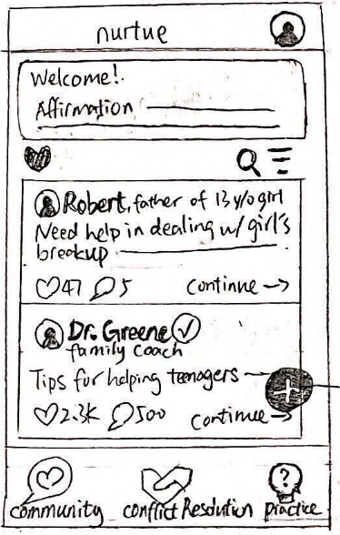
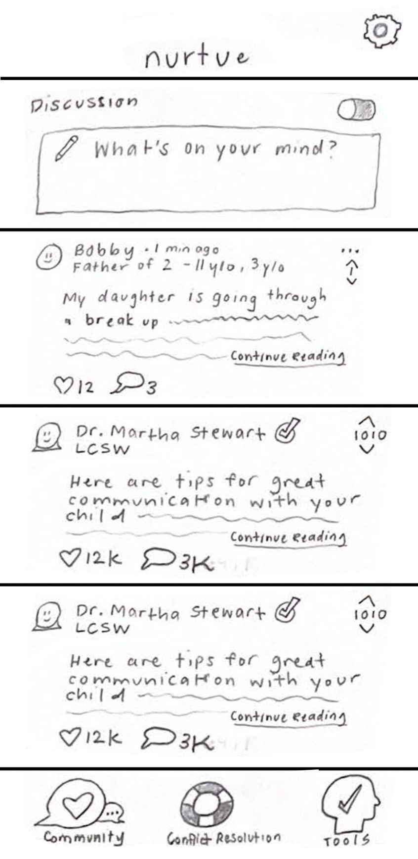
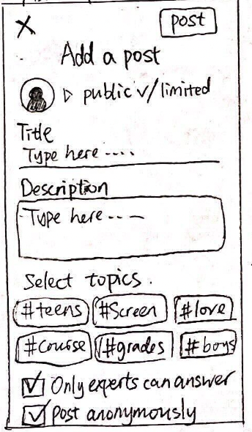
Major Change #1
Removed the text input box and added a plus button that opens a modal in the Community tab.
Rationale
From our low-fi testing:
The way to add new posts/conflict resolutions were inconsistent: for posts, users would type in a text box at the top; for new conflict resolution, users would tap the plus button at the bottom.
We revised the task flow to make the experience consistent across different tabs.
Before
After

Slide 13
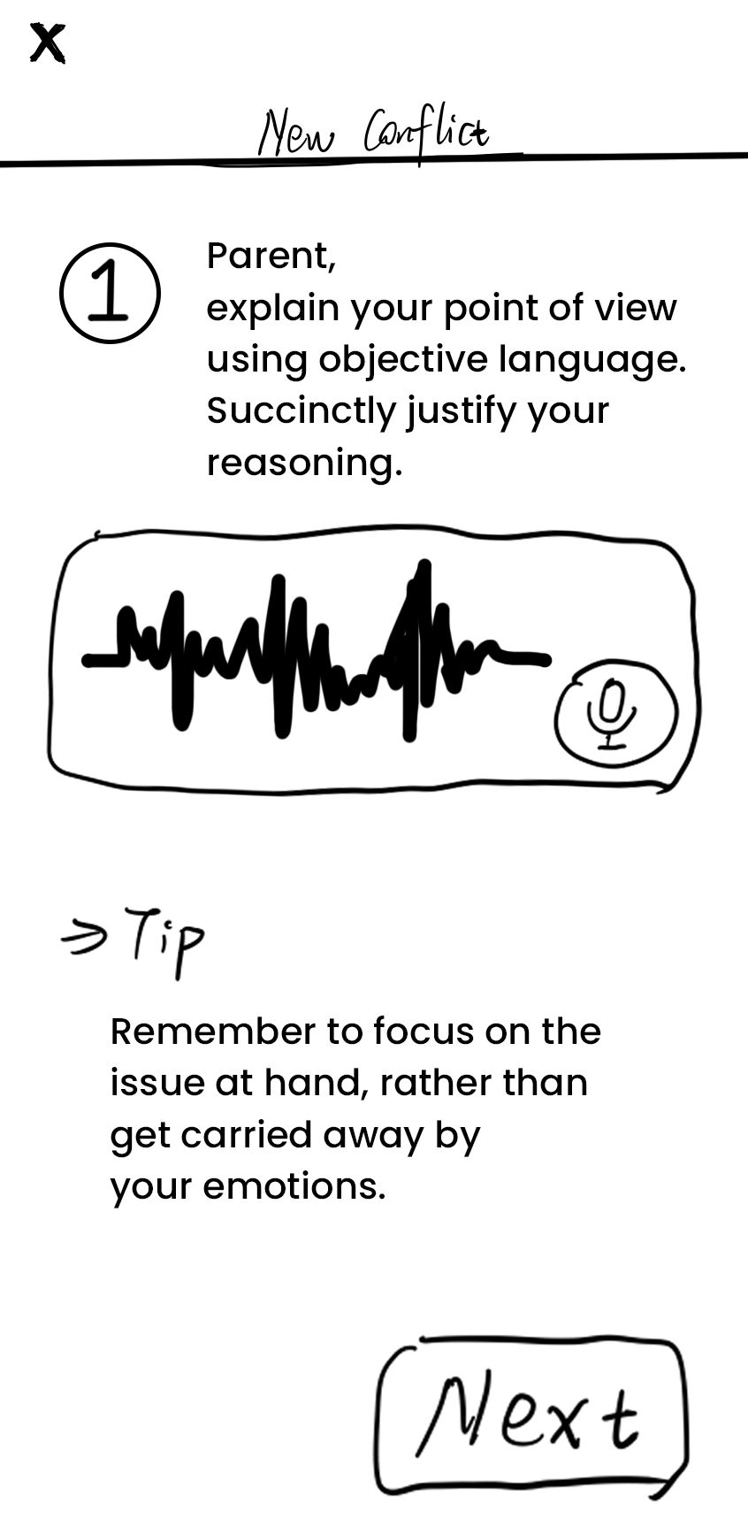
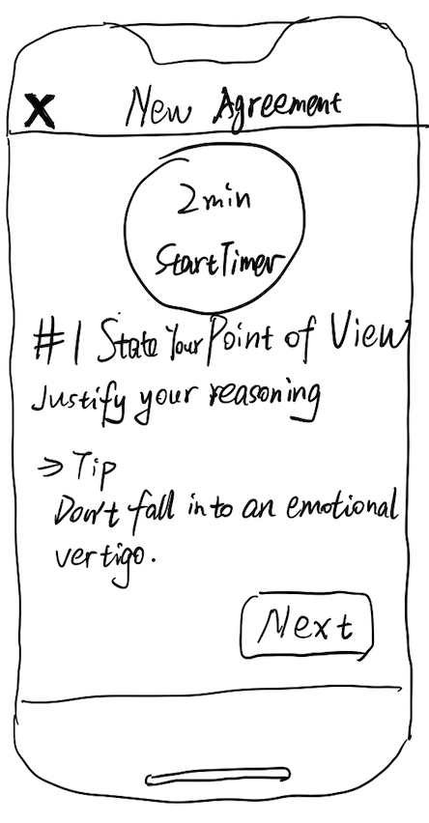
Major Change #2
Added a timer to each conflict resolution step; removed the recording input requirement before reaching the agreement.
Rationale
From our low-fi testing:
Users complained about tedious steps. One completely ignored the input area.
Users think setting a timer can stay focused while solving conflicts and keep them on task.
From our usability goals:
Some users didn’t notice the recording UI and didn’t understand what they were supposed to do on the page, which made it fail to meet the goal of overall success.
Before
After

Slide 14
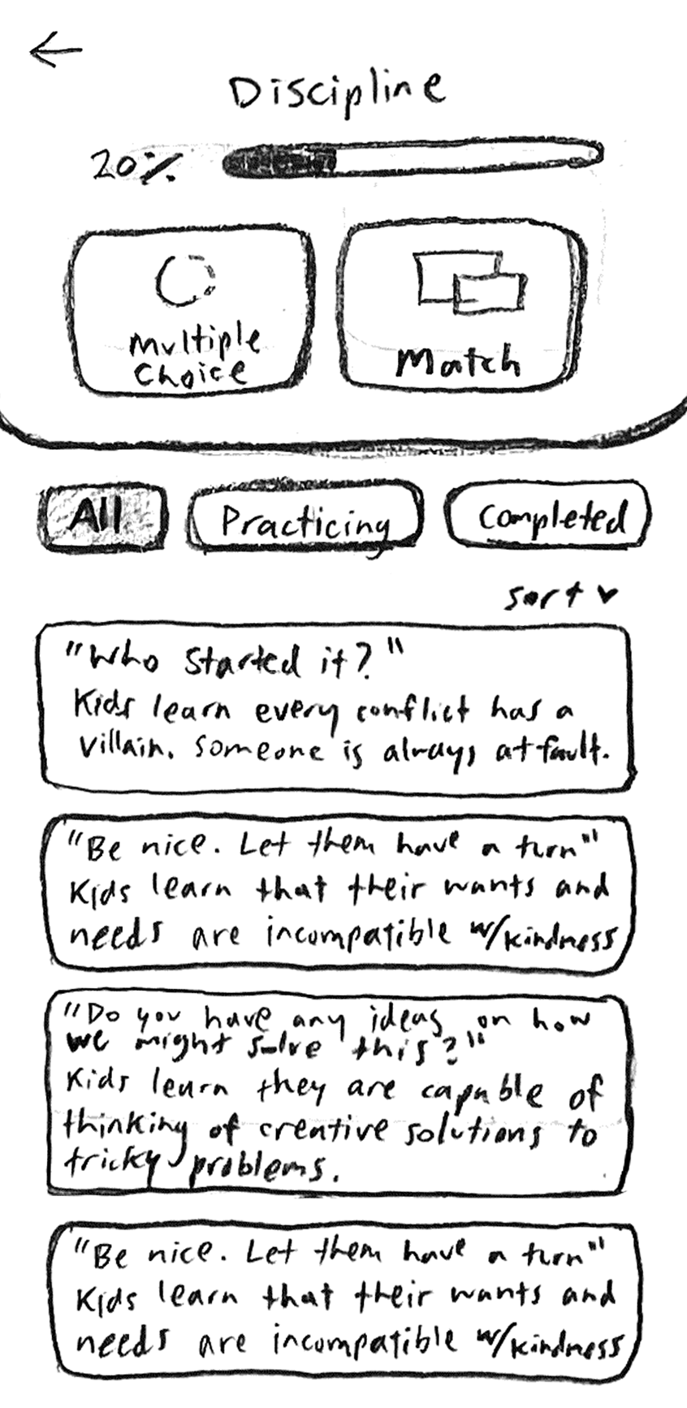
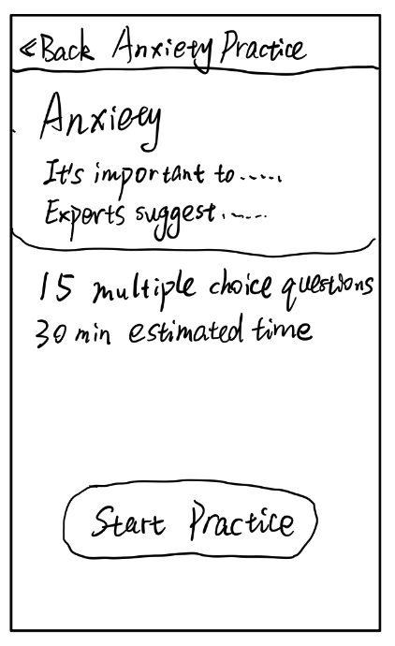
Major Change #3
Simplified the practice page to make it clean and action-focused.
Rationale
From our low-fi testing:
Users’ eyes landed on the educational content rather than the buttons above to start practicing.
From our usability goals:
Users became stuck or took an incorrect path on the way to completion, which failed to meet the accuracy goal.
Before
After

Slide 15
Additional
Needfinding
Medium-Fi Prototype
Task Flows

Slide 16
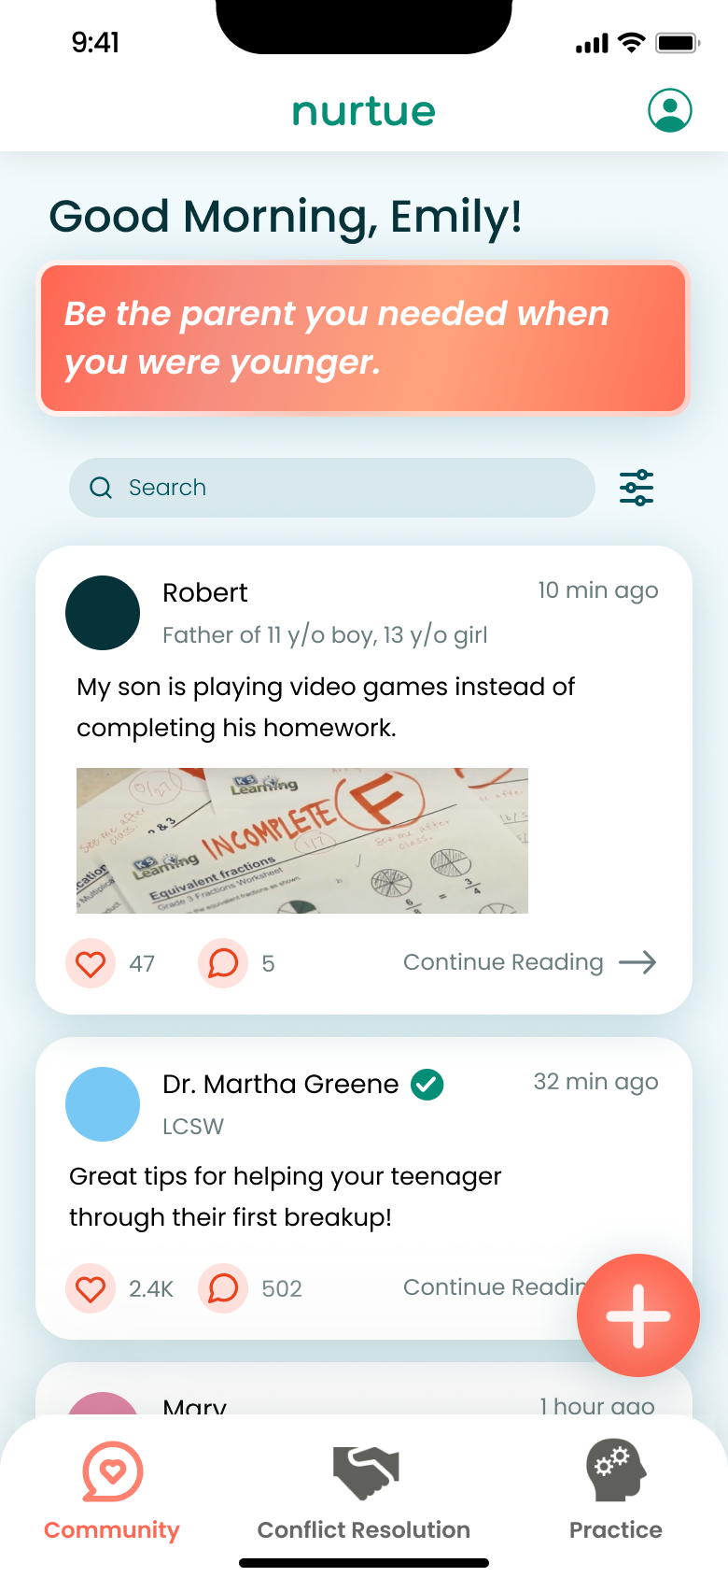
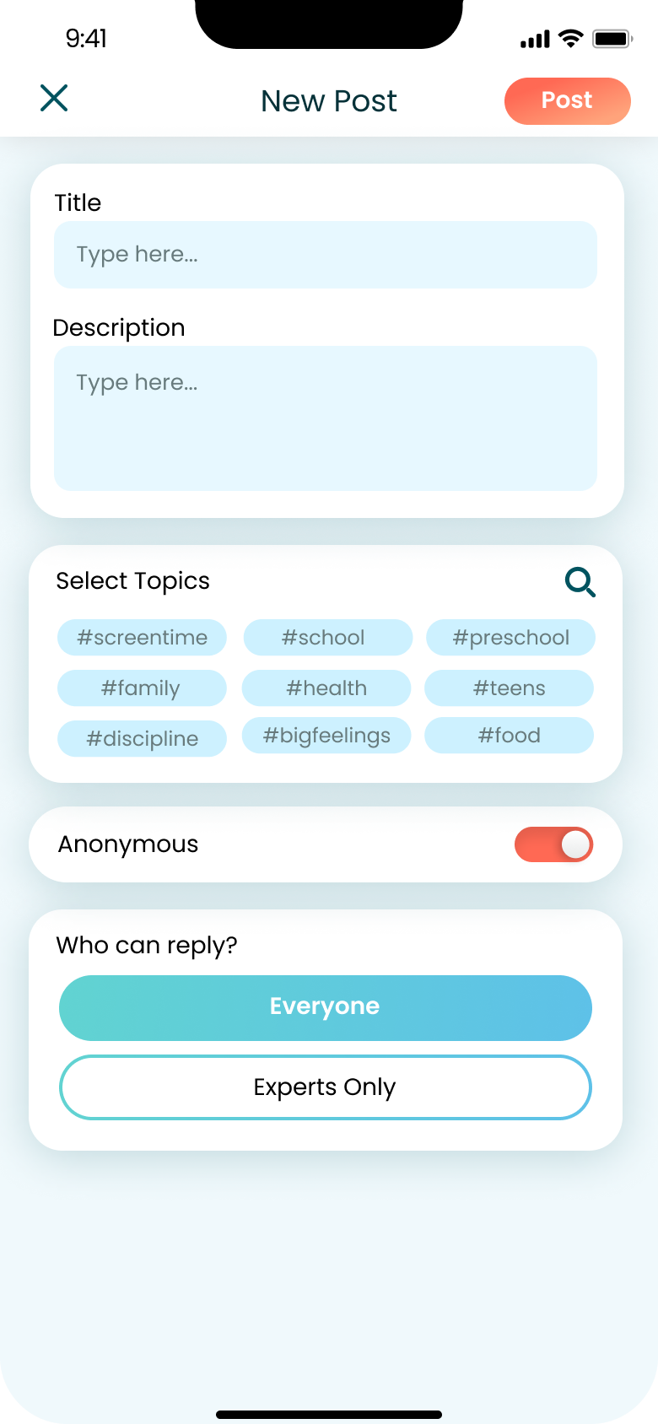
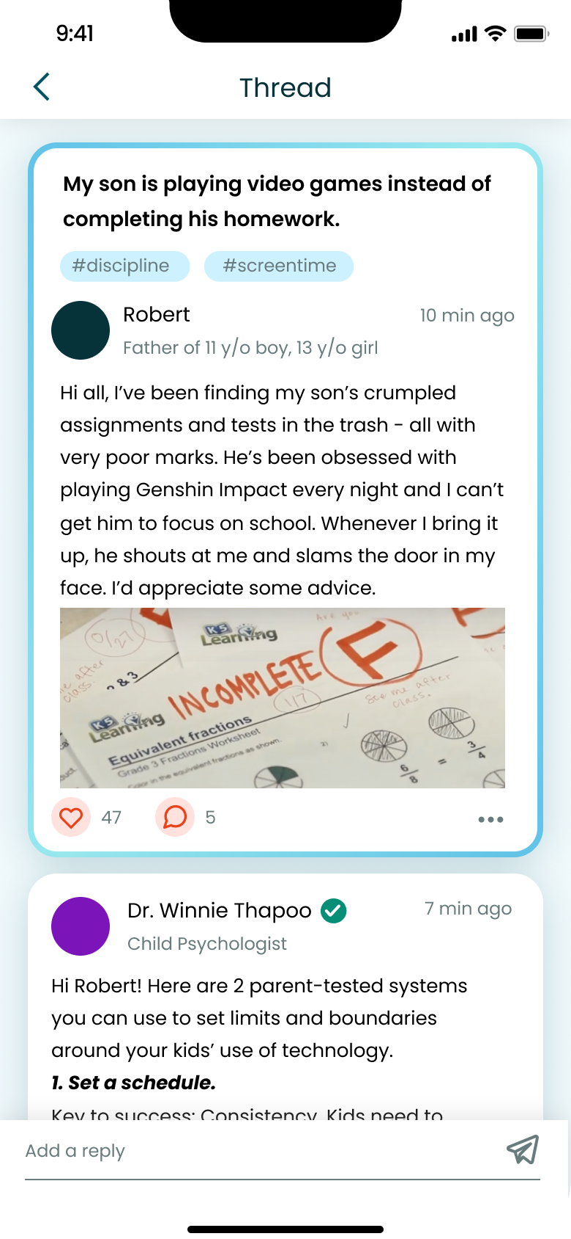
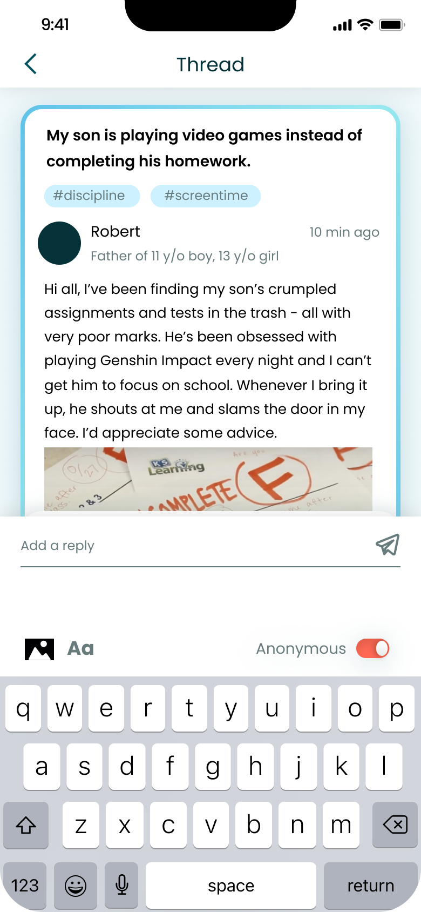
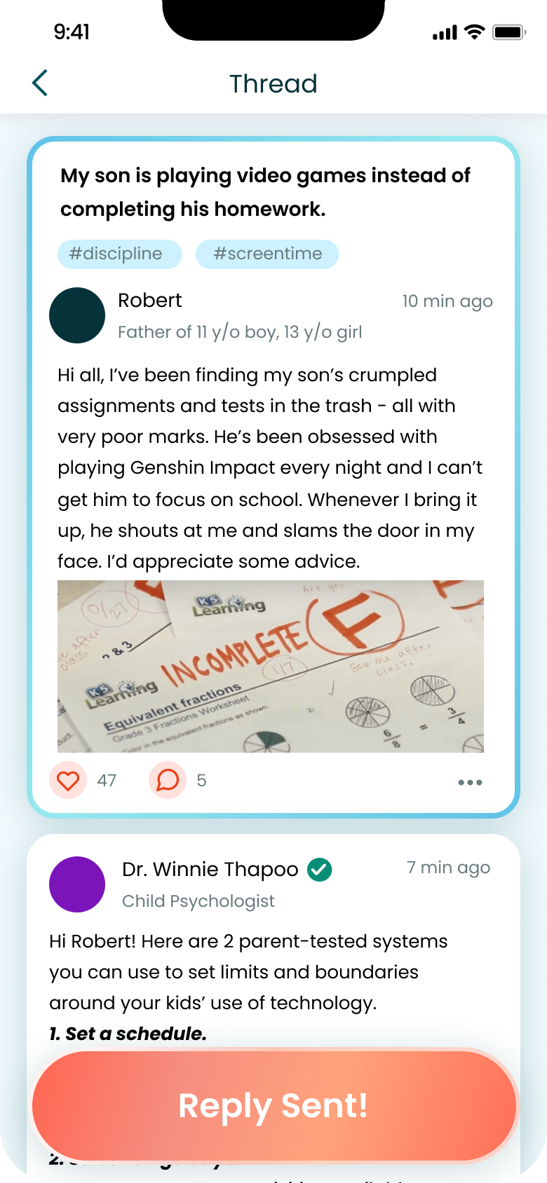
[Simple Task] Share your parenting struggles to get advice from fellow parents or/and experts in the field.
Click to read the post in detail
Back
Back
Back
Back
Click to add a new post
Click to add a new reply

Slide 17
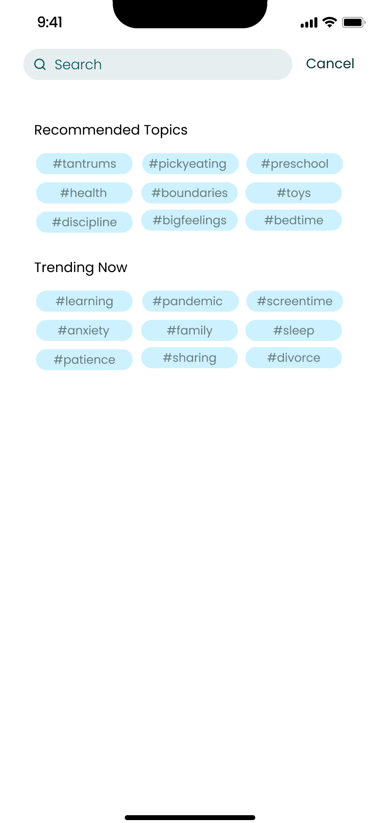
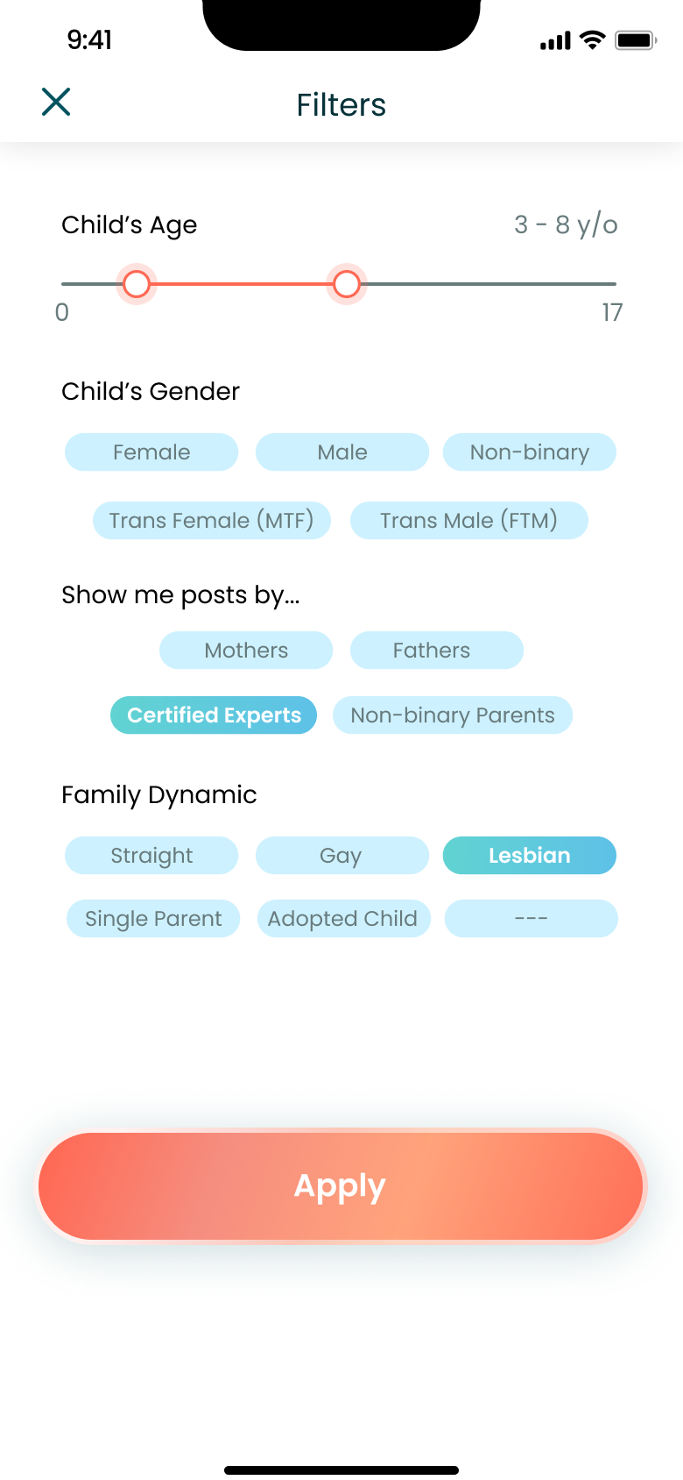
[Simple Task] Share your parenting struggles to get advice from fellow parents or/and experts in the field. (Filter and Search)
Back
Filter posts
Search community
Back
Apply filter

Slide 18
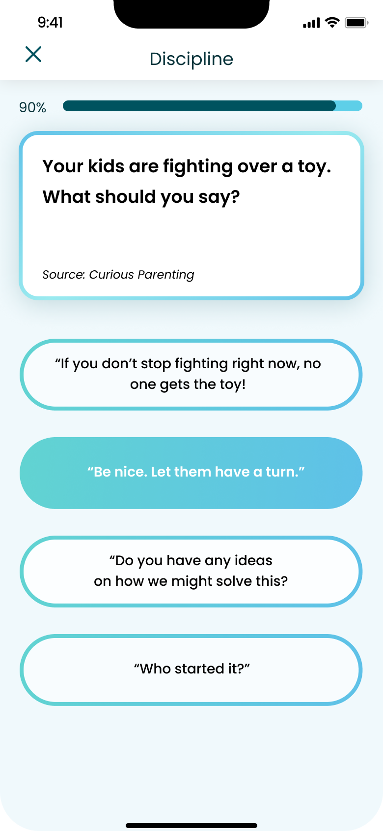
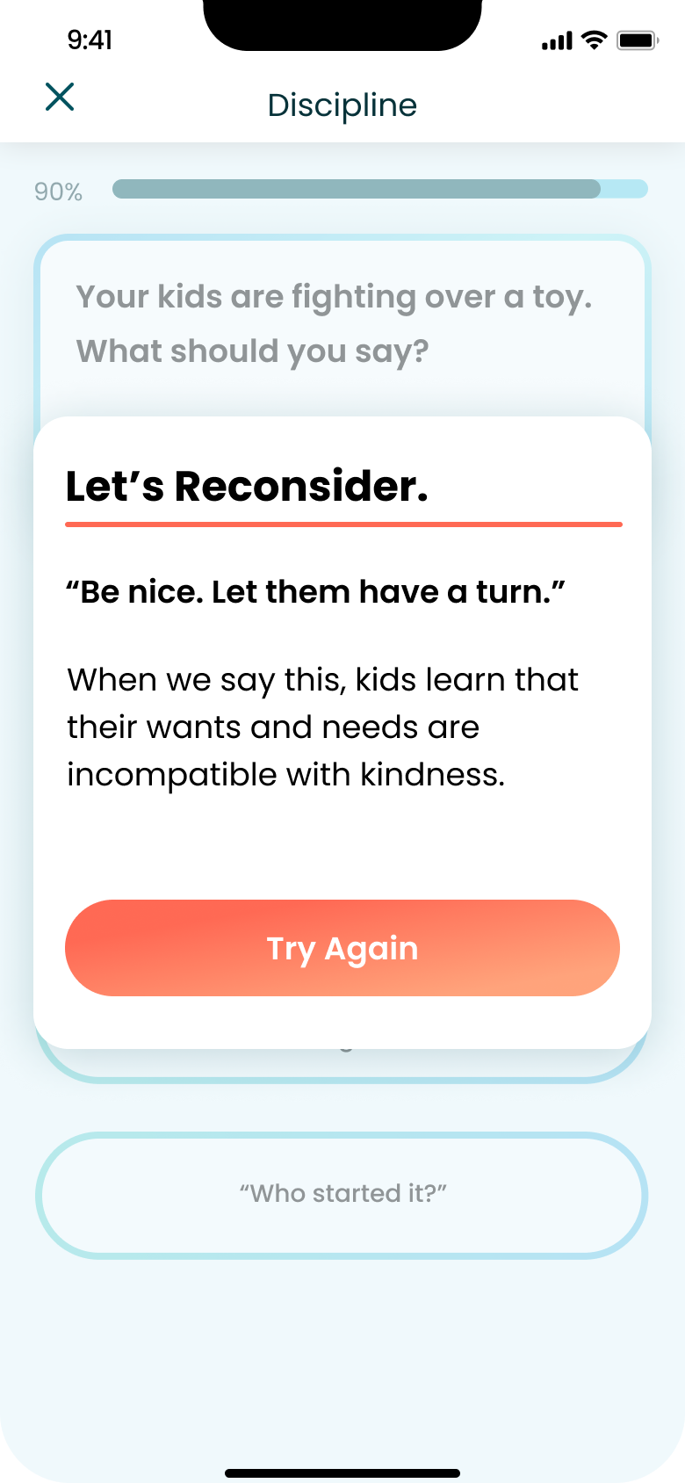
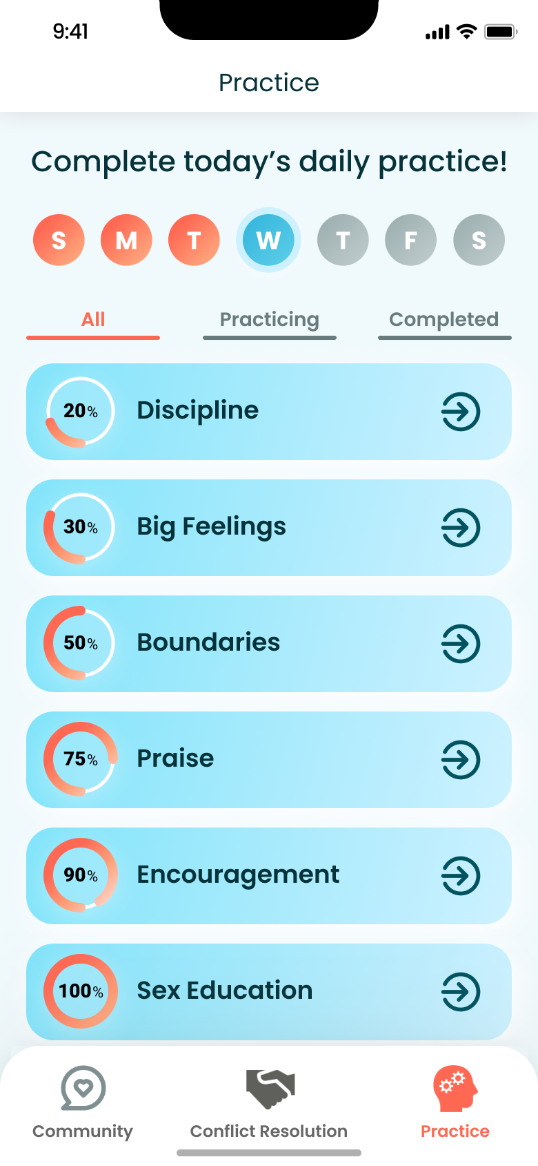
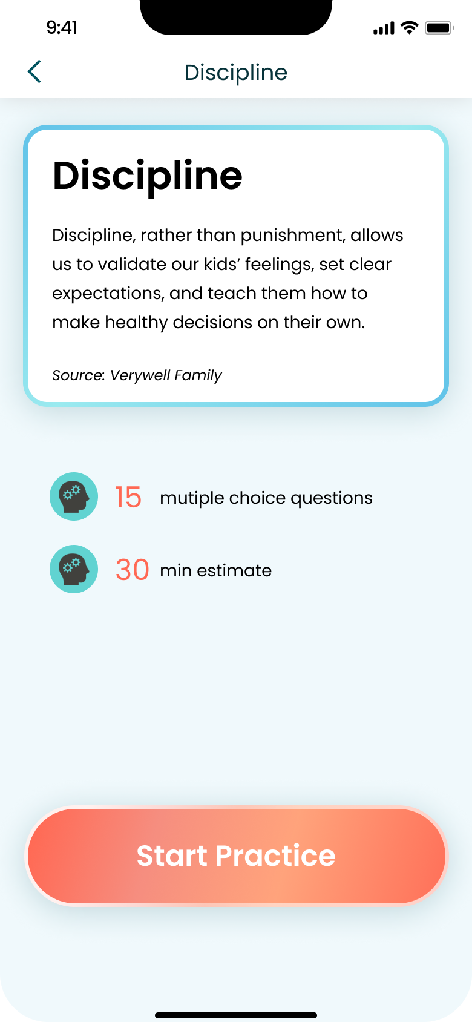
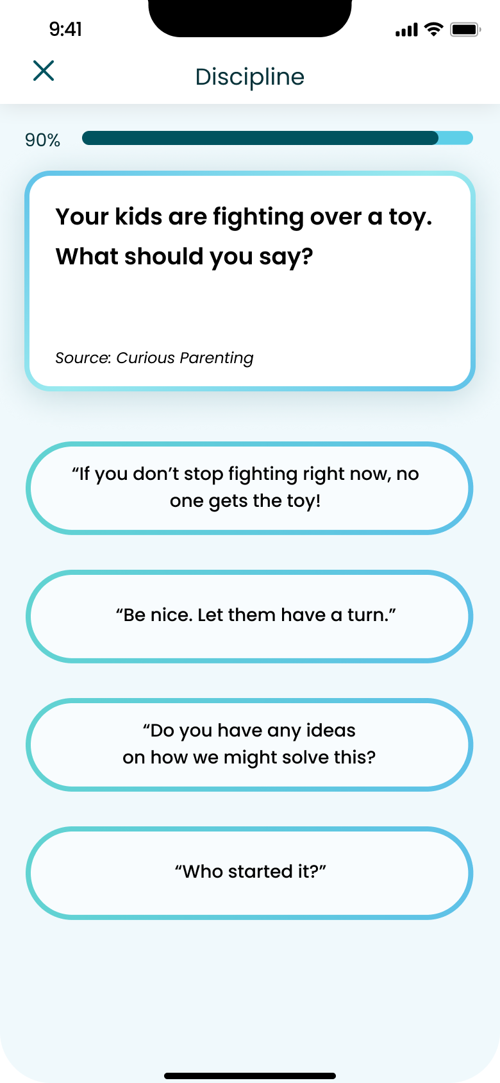
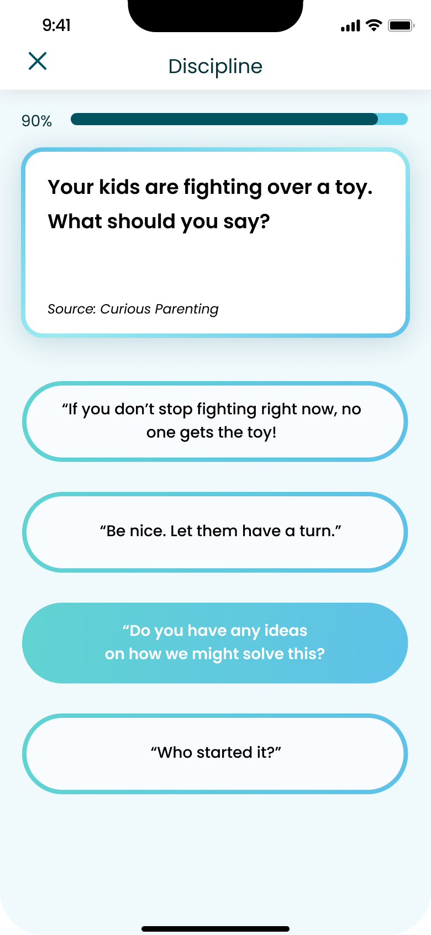
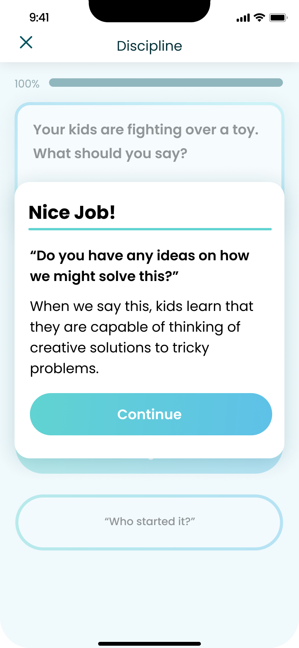
Back
[Moderate Task] Practice more effective language to communicate with your child through interactive modules.
Back
Back
Back
Choose wrong answer
Click
Back
Back
Choose correct answer
Click

Slide 19
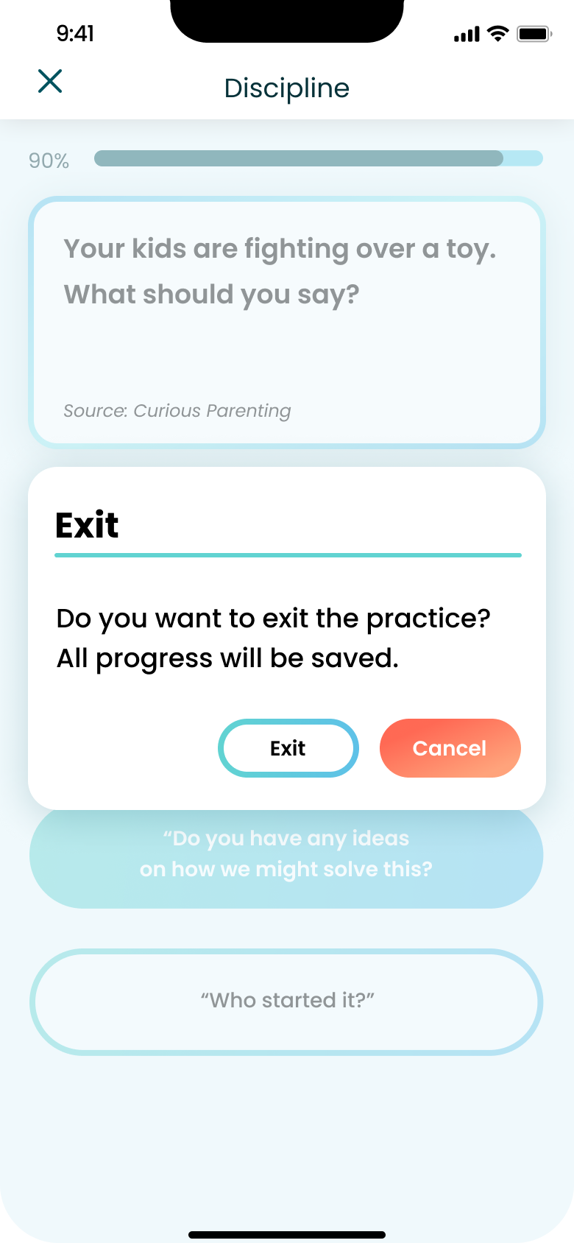
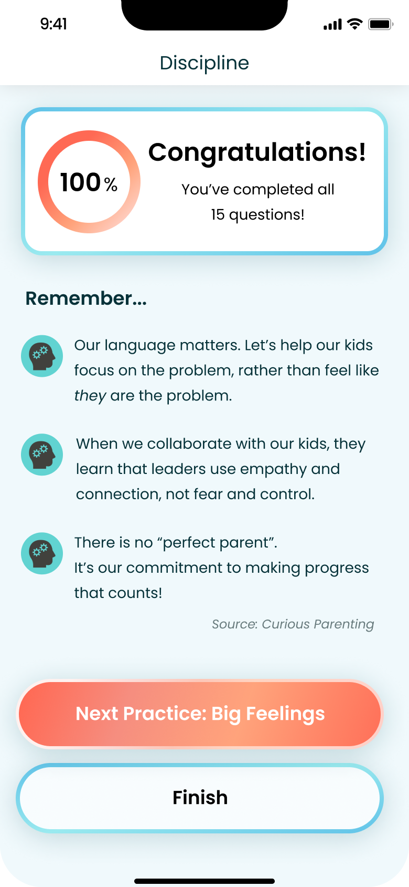
[Moderate Task] Practice more effective language to communicate with your child through interactive modules. (Exit exercise)
Back to practice page
Proceed to next module

Slide 20
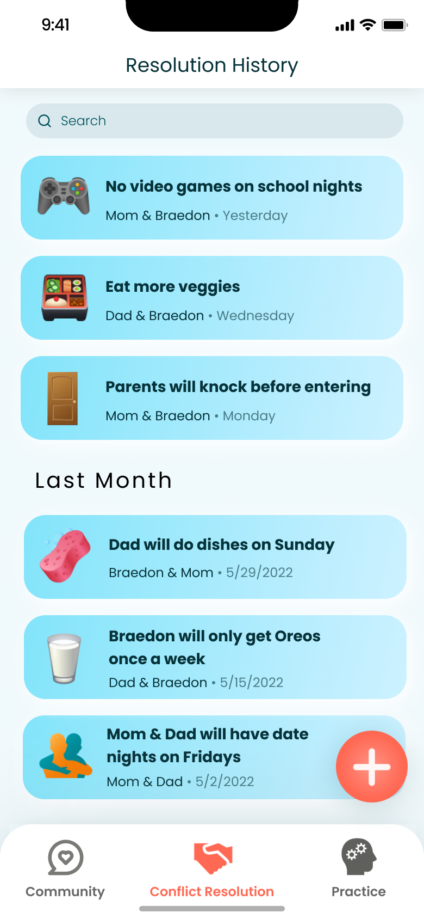
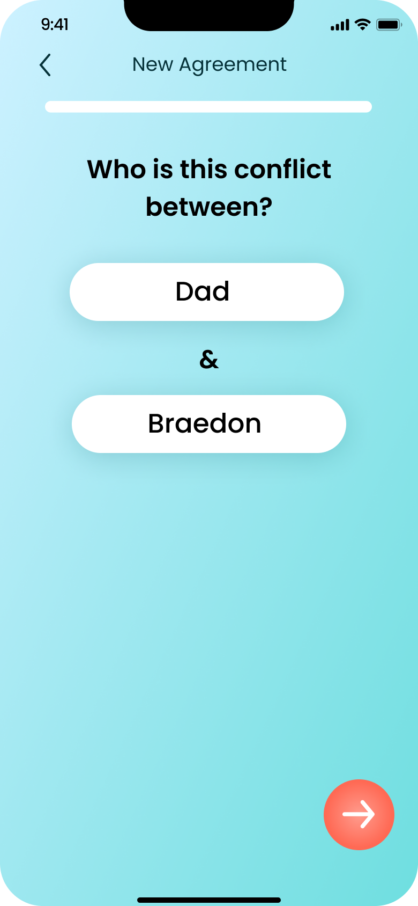
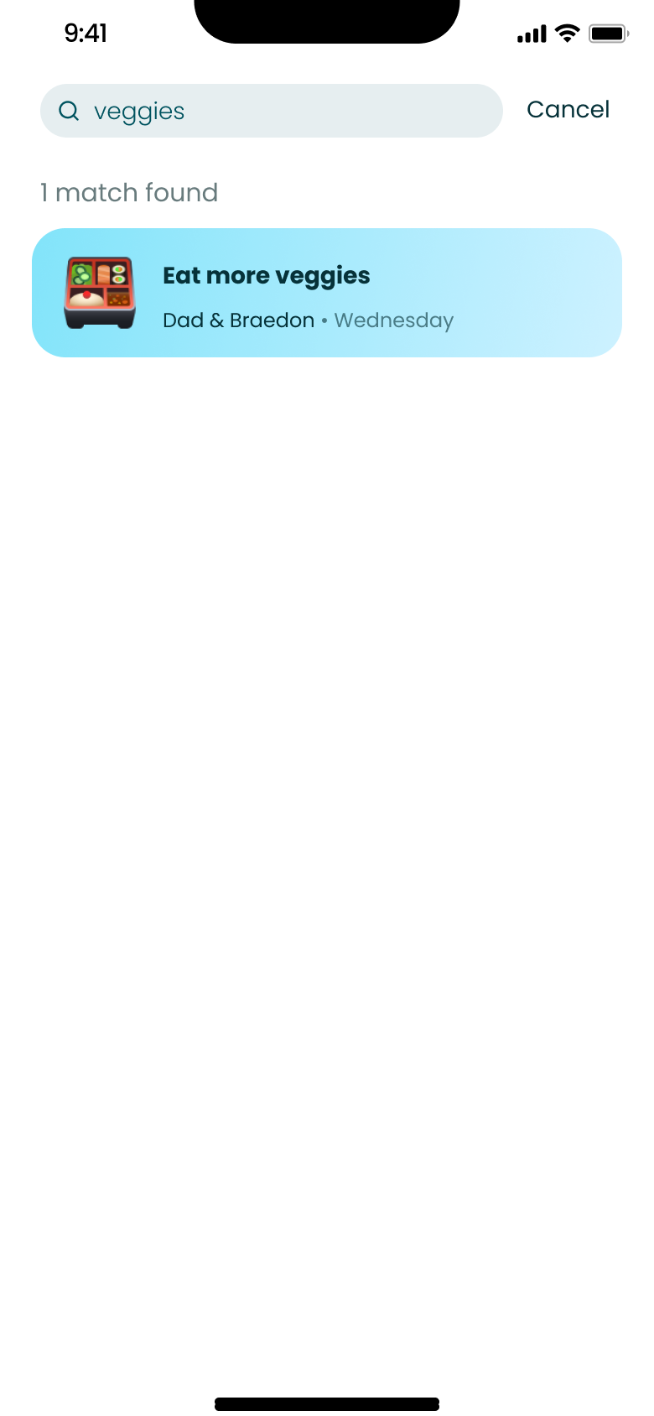
[Complex Task] Resolve a particular conflict with a child in a peaceful manner, and come to an agreement that the parent can reference.
Search agreement
Back
Back
Proceed (see next slide)
Solve a new conflict

Slide 21
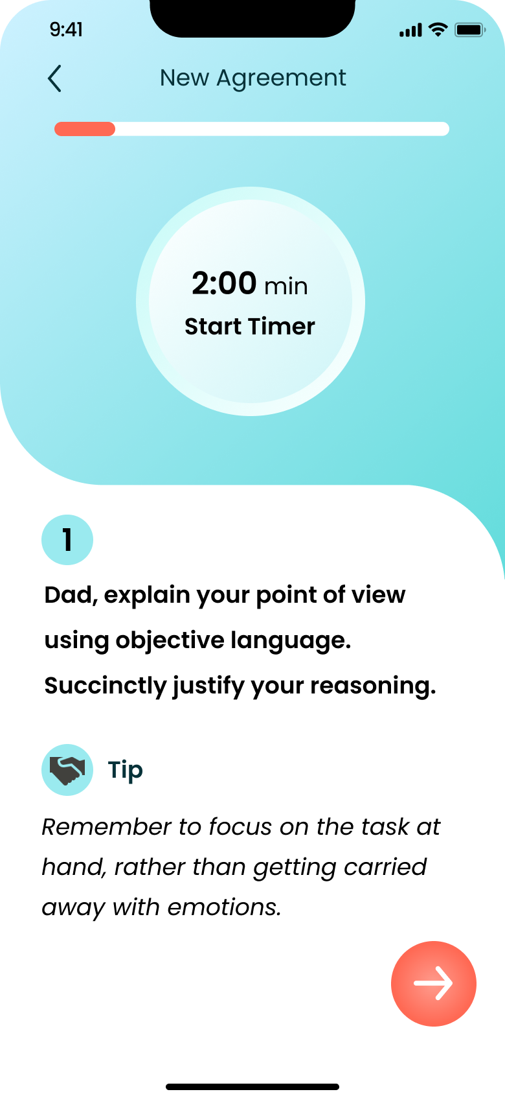
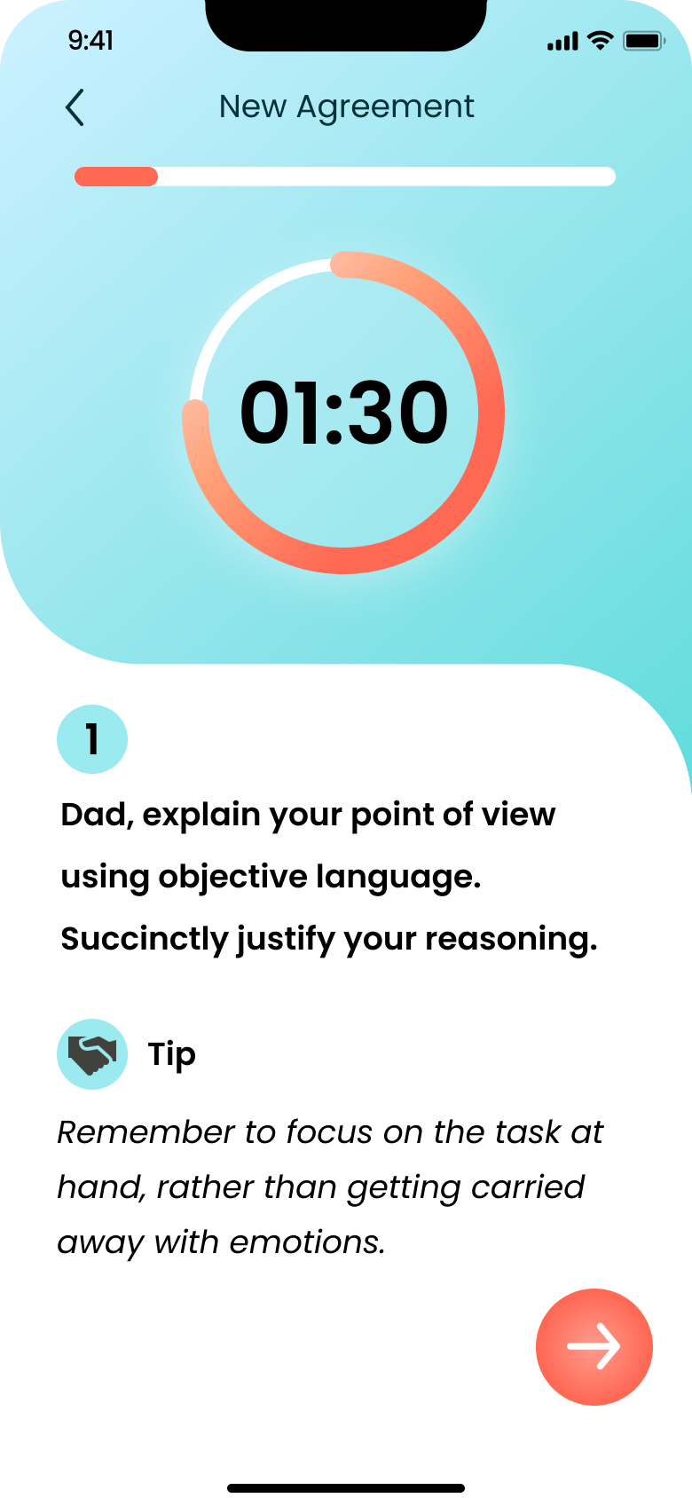
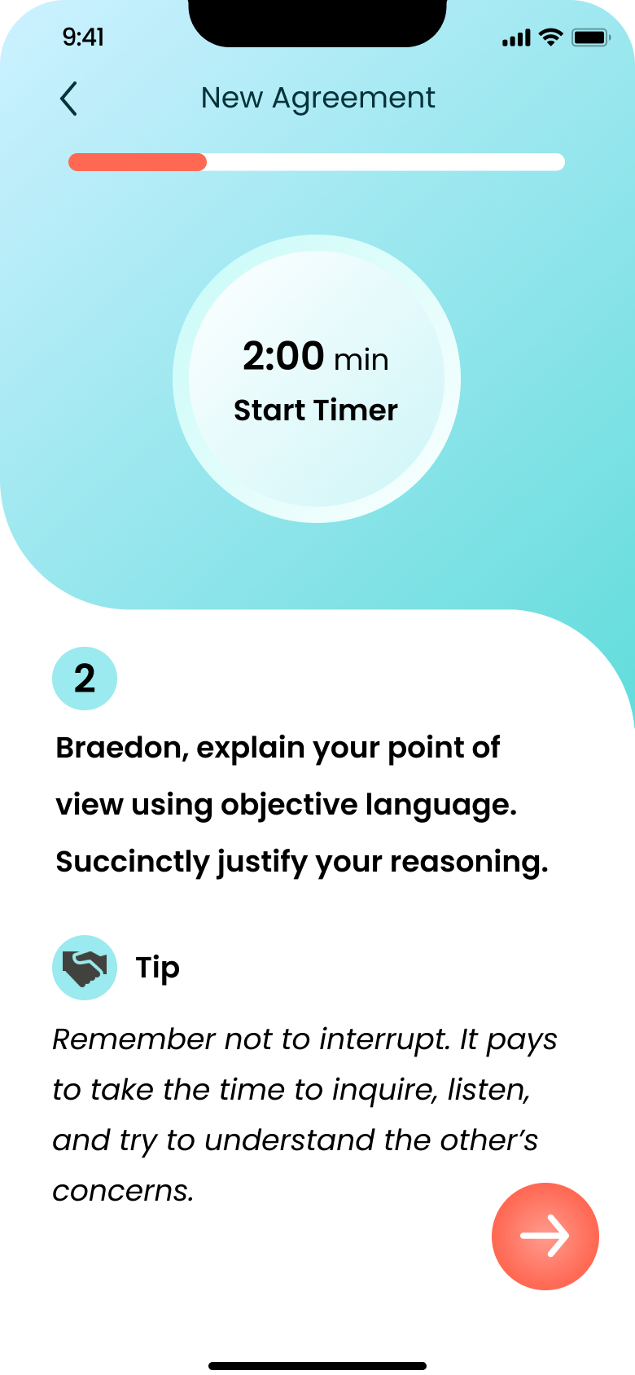
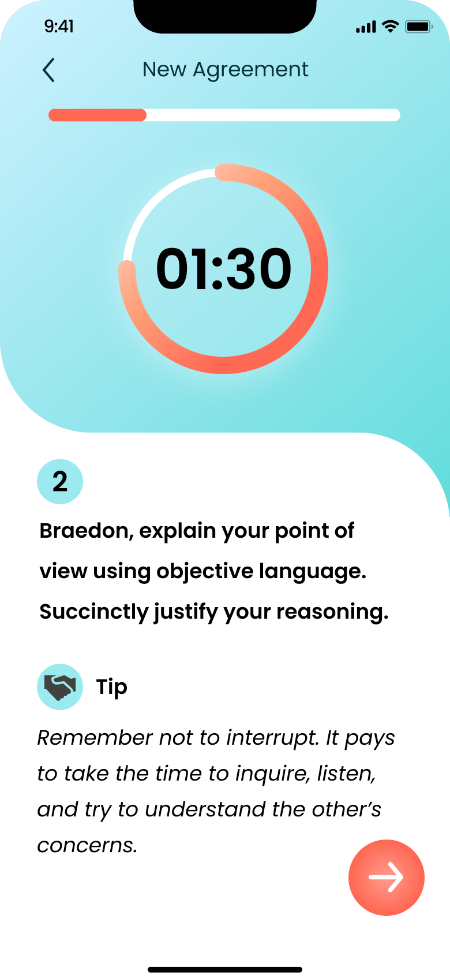
[Complex Task] Resolve a particular conflict with a child in a peaceful manner, and come to an agreement that the parent can reference. (Continued)
Back
Back
Back
Back
Activate timer
Activate timer
Proceed (see next slide)
Proceed
Proceed
Proceed

Slide 22
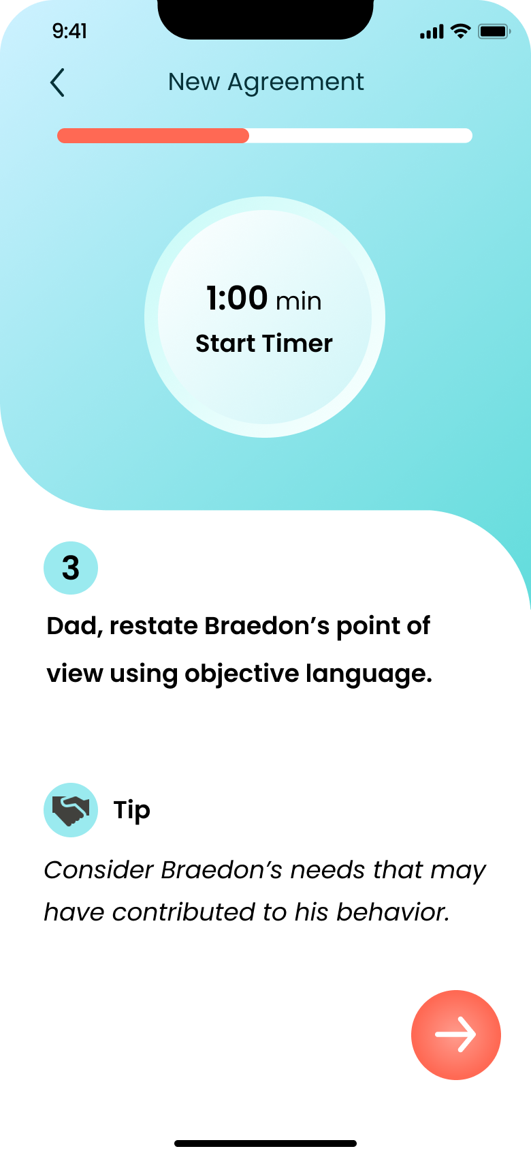
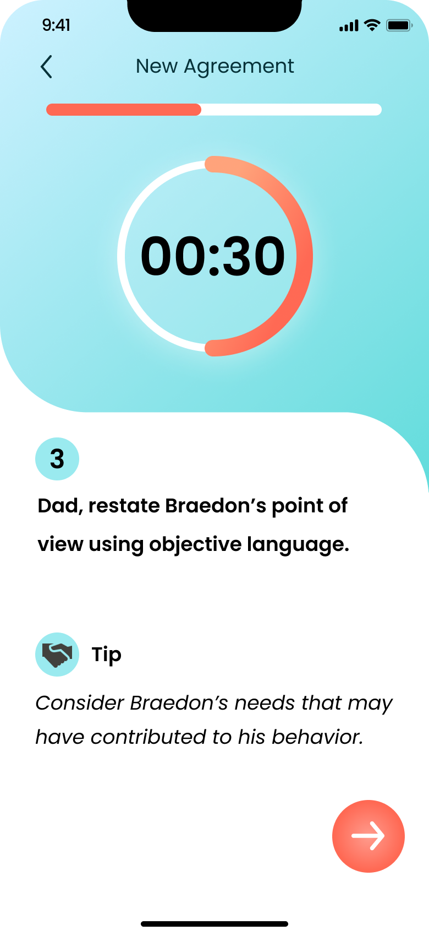

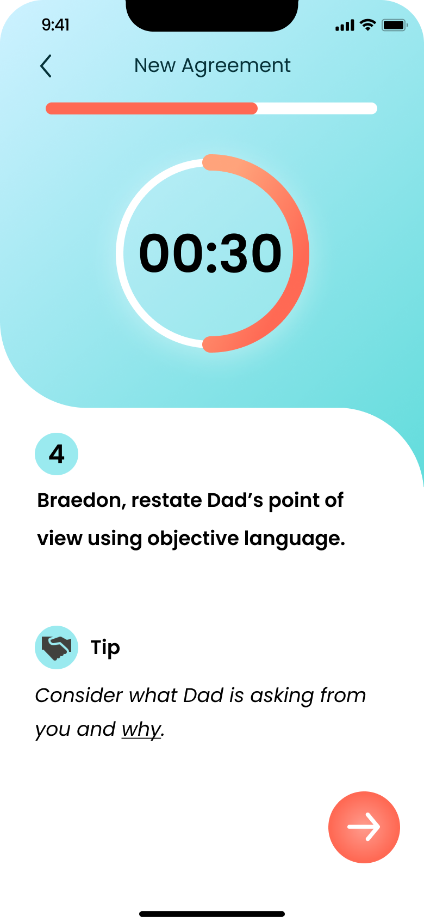
[Complex Task] Resolve a particular conflict with a child in a peaceful manner, and come to an agreement that the parent can reference. (Continued)
Back
Back
Back
Back
Activate timer
Activate timer
Proceed (see next slide)
Proceed
Proceed
Proceed

Slide 23
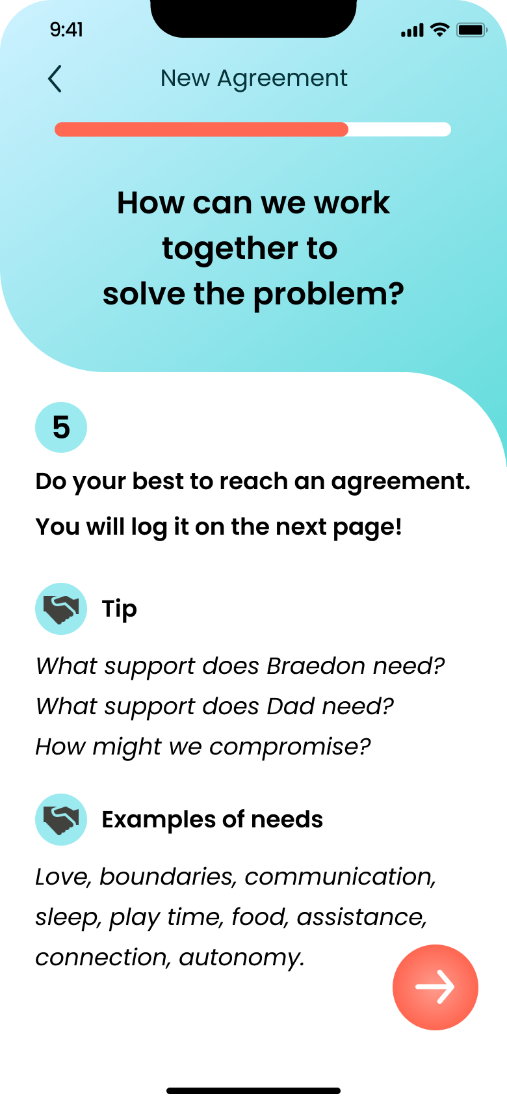
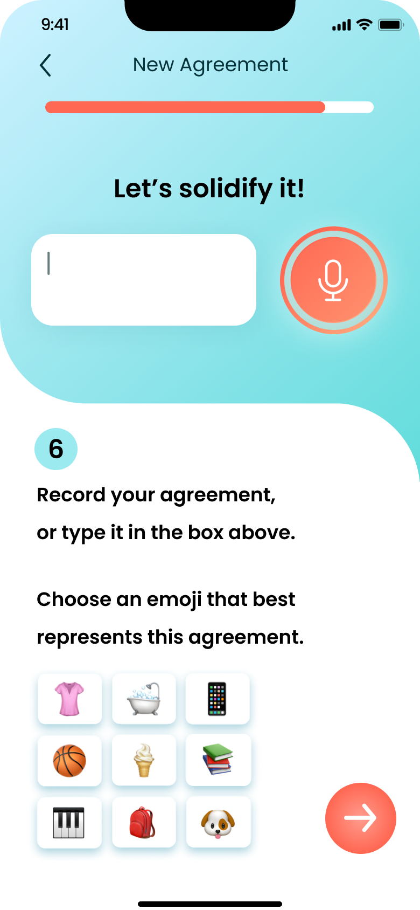
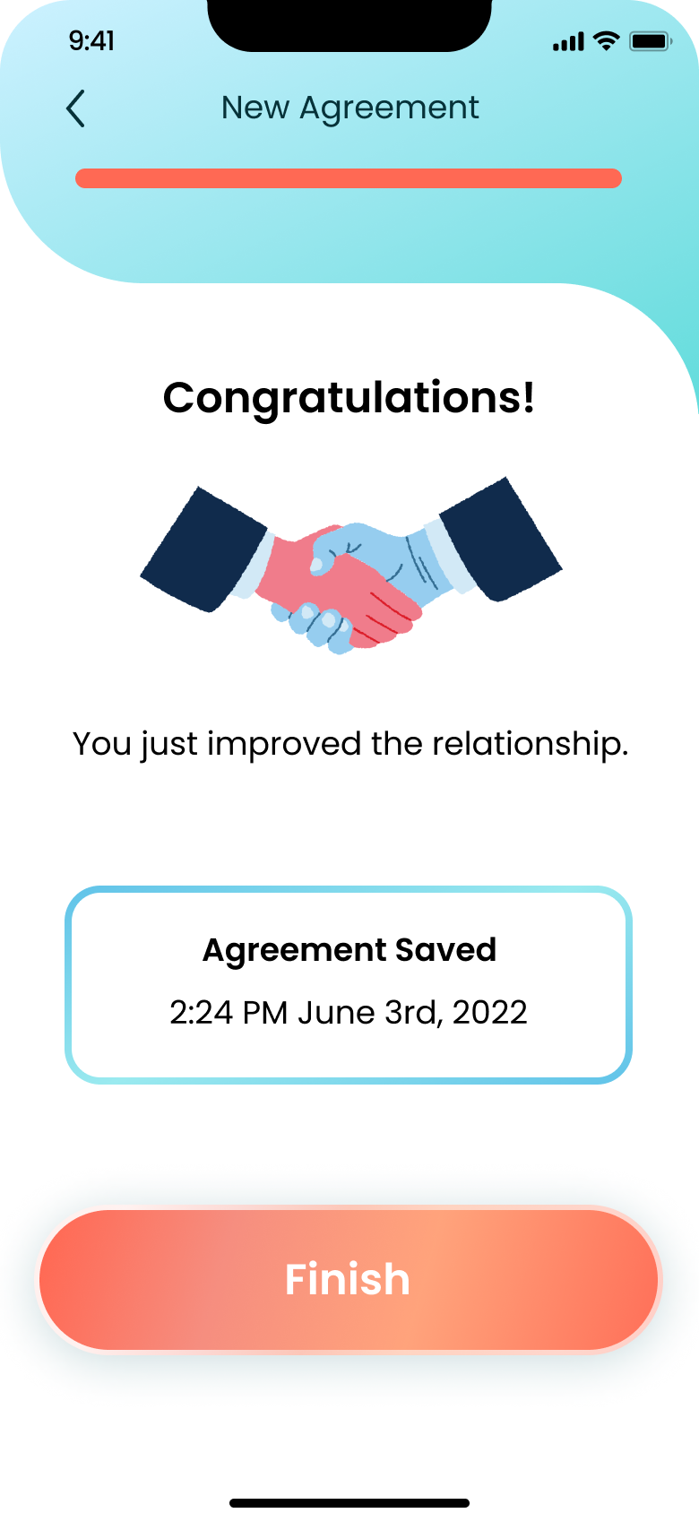
[Complex Task] Resolve a particular conflict with a child in a peaceful manner, and come to an agreement that the parent can reference. (Continued)
Back
Back
Back
Back to conflict resolution page
Proceed
Proceed

Slide 24
Additional
Needfinding
Prototype Overview

Slide 25

We use Figma as our design and prototyping tool.
What was easy
What was difficult
It provides us with real-time online collaboration which makes the iteration of design, feedback, and exploring possibilities easier across the team.
It also supports turning the design into a working prototype with clicks/taps and navigation, just like a mobile phone app.
Figma has a learning curve for newcomers.
It takes some trial and error to successfully set up the prototyping navigation.
We are glad that by the end of A6 we have made great progresses in using Figma!

Slide 26
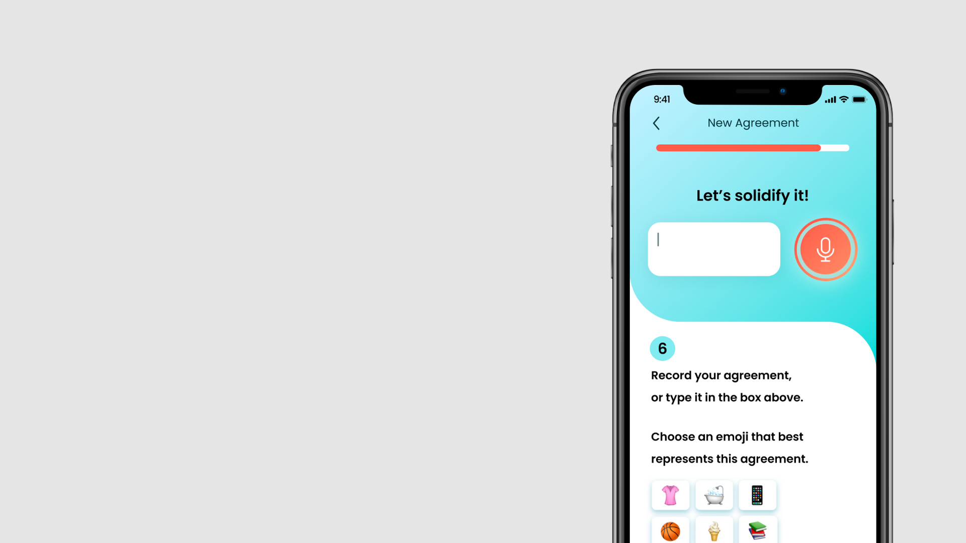
Limitations
We only implemented functional screens that cover our main features. Some screens or views such as Settings and Profile are not implemented yet, since they contain least-used functionalities and most of them are standardized procedures that are not unique to our app.
Users cannot do things that could change the data, such as successfully posting a question, or seeing the new agreement you just reached with your children in history, since most data is still hard-coded.
Most screens show the pre-defined stale text, since we only have a limited amount of mock data.
Actions that require actual mobile phone systems are not available, such as typing, recording and counting down on a timer.
[Mock]

Slide 27
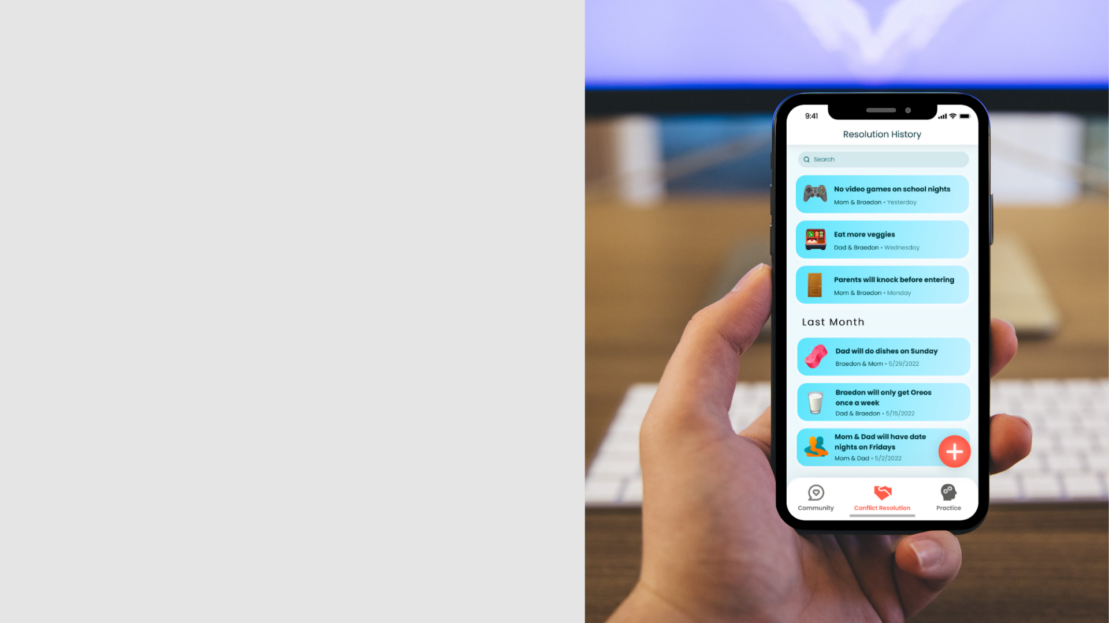
Wizard of Oz
Hard-coded Items
Recommendations and personalizations will have to be implemented by Wizard of Oz such as Recommended Topics and Trending Now, since it’s a completely different story to build a recommendation system.
All user profiles. The user profiles/avatars in the Community tab are mocked.
Community posts made by parents and experts. These contents are generated by ourselves and do not represent real parents or experts’ opinions.
All practice questions. We don’t have comprehensive practice sets.
Entries in the Resolution History. We put in some hard-coded agreements to showcase the design.

Slide 28
Additional
Needfinding
Additional Prototype Screenshots

Slide 29
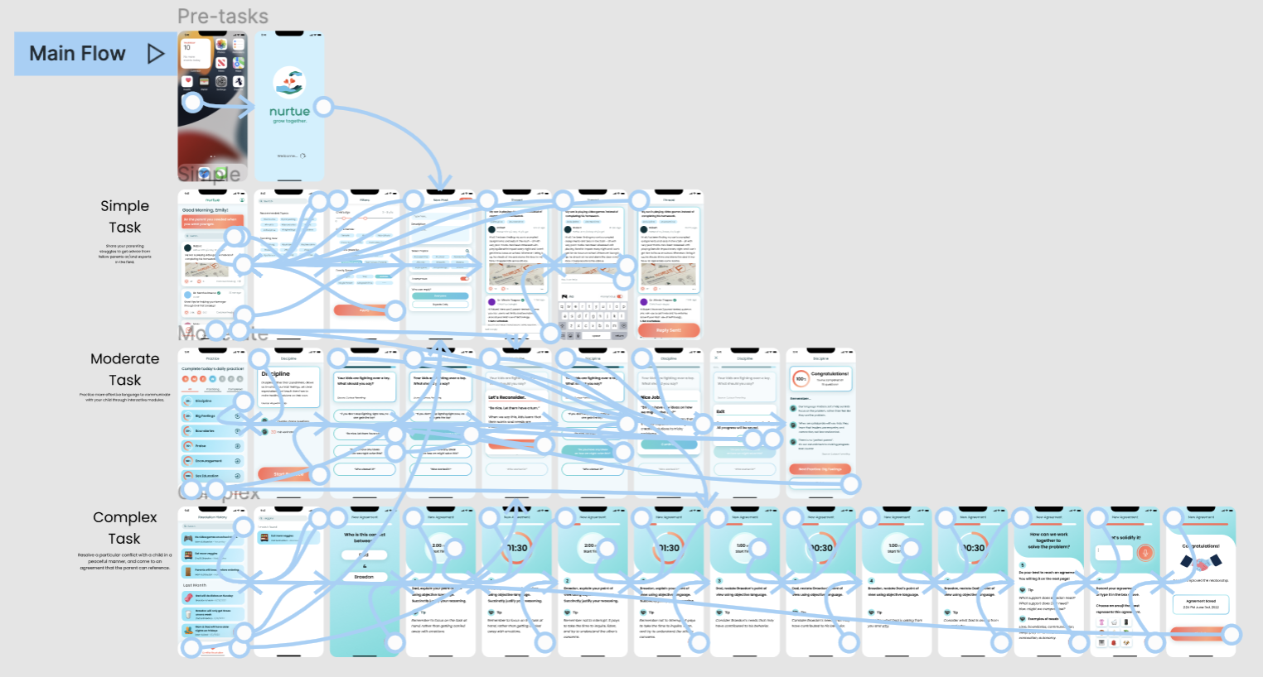
Figma Prototype (Link)

Slide 30
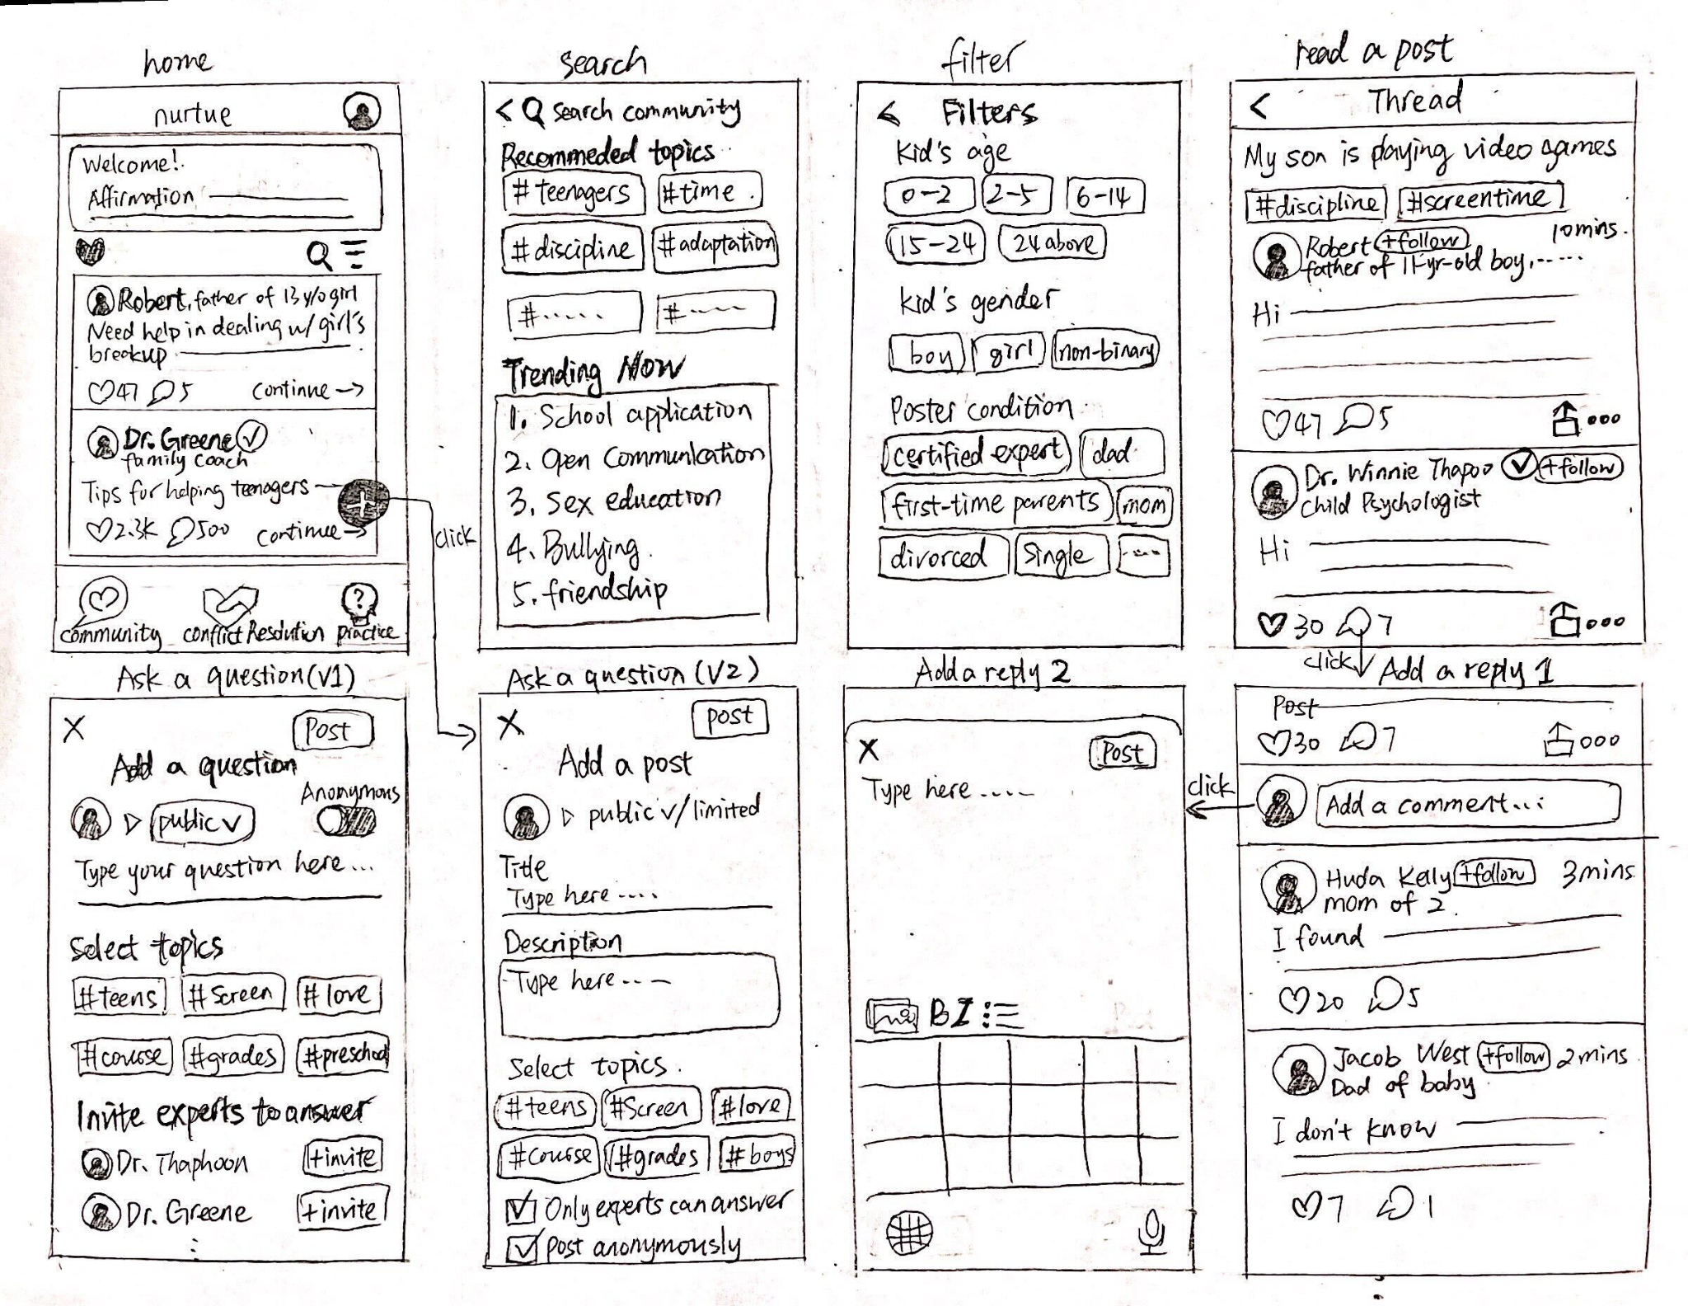
Revised Simple Task Sketches
Share your parenting struggles to get advice from fellow parents or/and experts in the field.

Slide 31
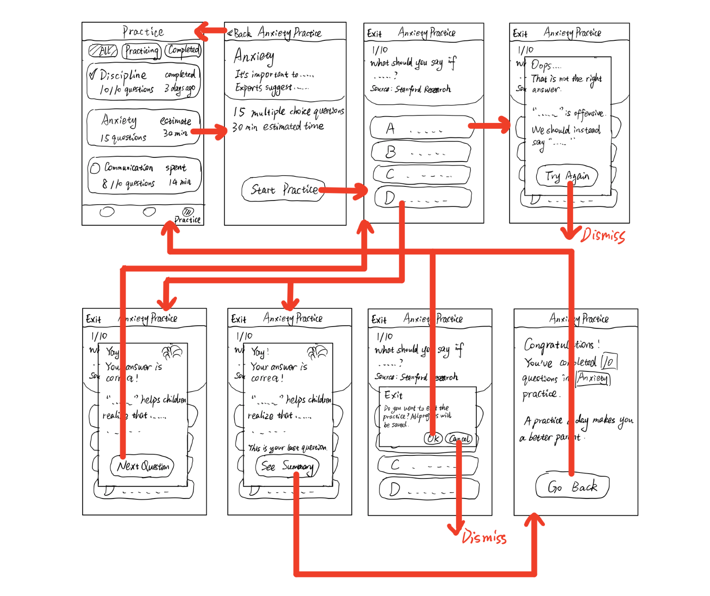
Revised Moderate Task Sketches
Practice more effective language to communicate with your child through interactive modules.

Slide 32
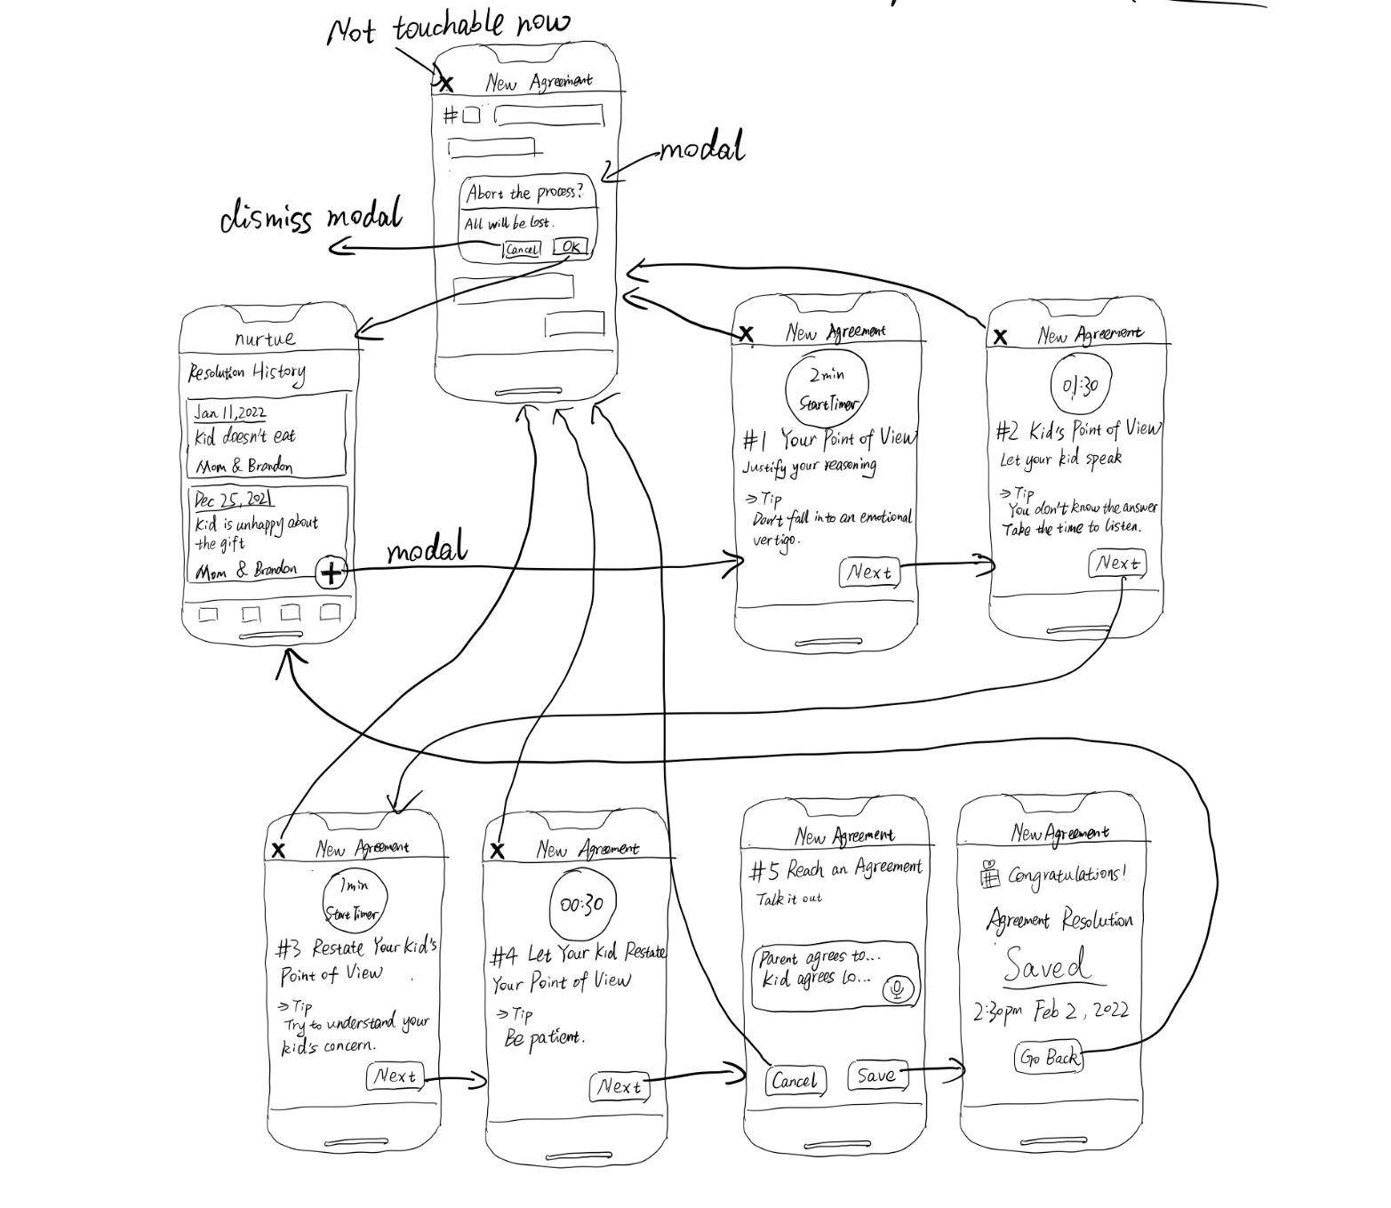
Revised Complex Task Sketches
Resolve a particular conflict with a child in a peaceful manner, and come to an agreement that the parent can reference.

Slide 33


Additional Med-Fi Prototype Screens

